Slide 1
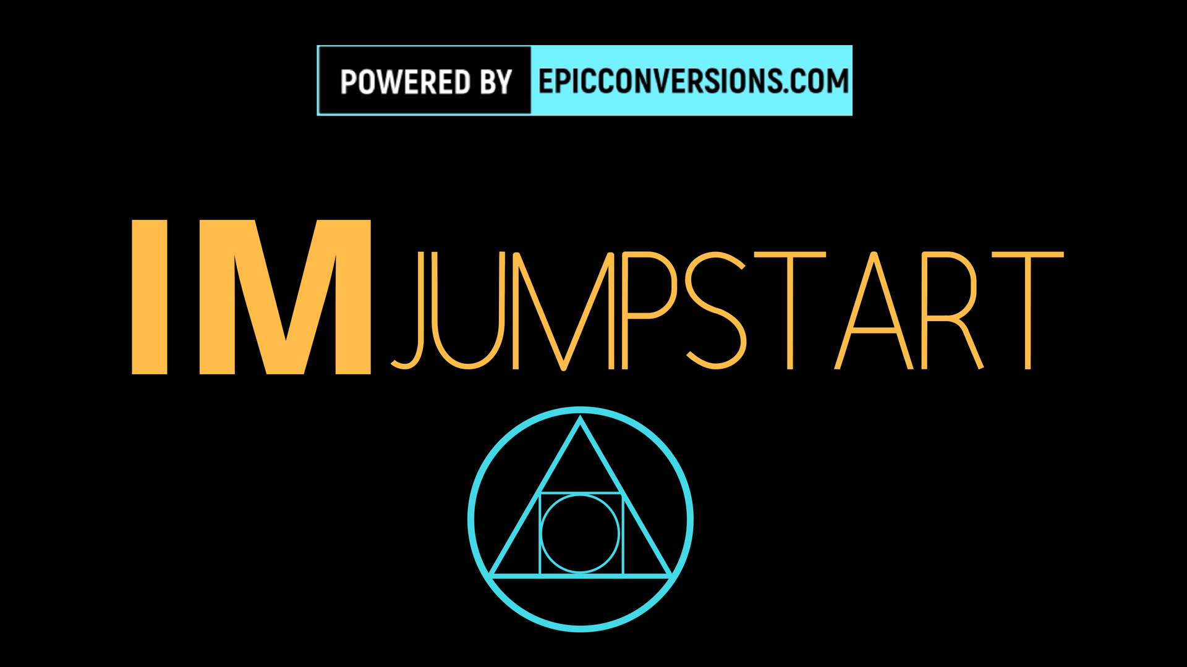
Notes:
Thank everyone for coming, what to expect, how long will it take, what we are going to be learning (brief overview) basic definitions of things

Slide 2
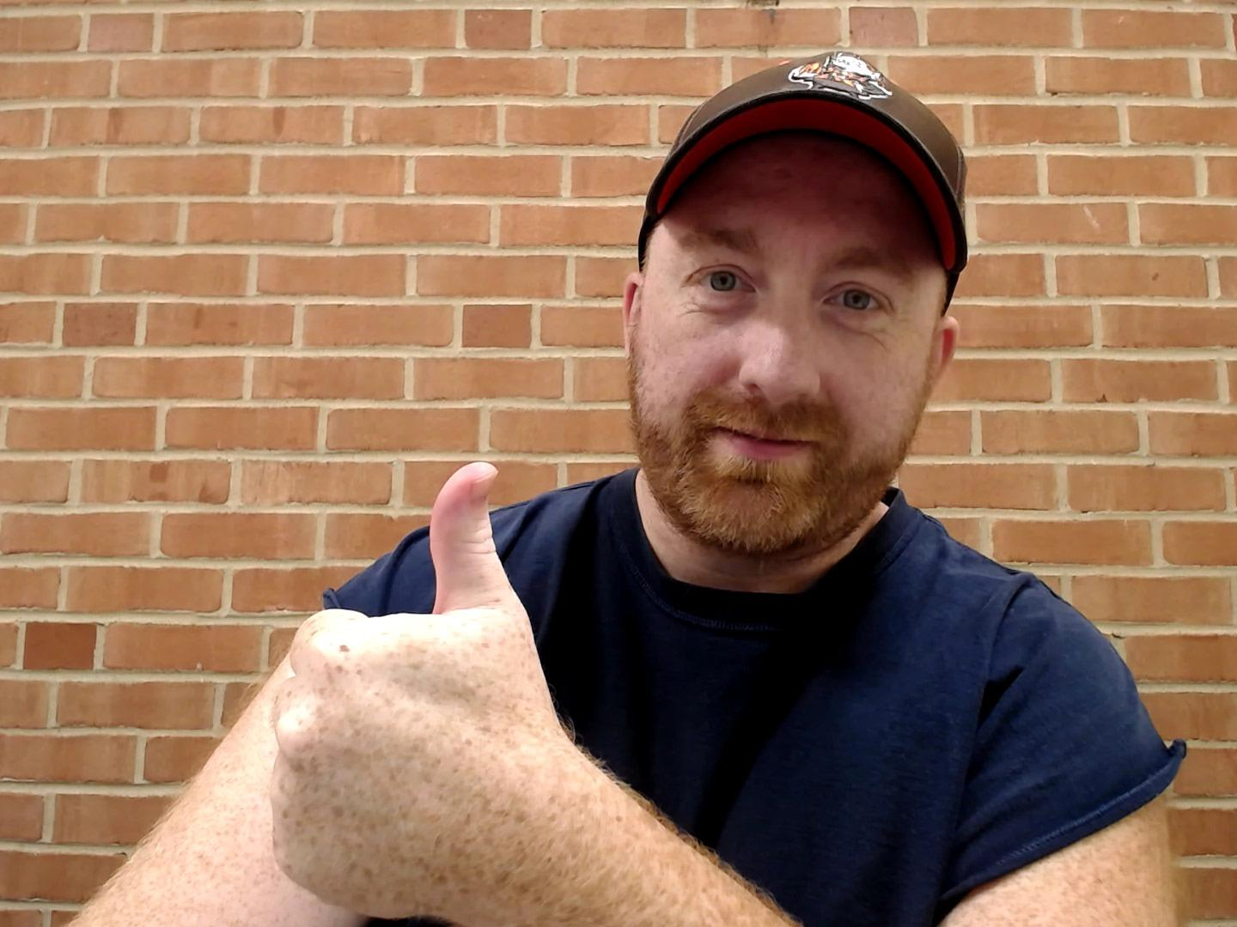
“My Weird Little Internet Business That’s Generated Over 100K and Allows me to BE MY OWN BOSS…”
And How You Can ETHICALLY Steal the whole thing in about 10 Minutes!
Notes:
WHo here wants to see behind the scenes on what that weird little business looks like?

Slide 3

DON’T USE THESE POWERS FOR EVIL...
Notes:
Promise me you guys aren’t going to use these powers for eveil ok?

Slide 4

EARNINGS DISCLAIMER...
For the love of all that is holy, just because I made a bunch of money, doesn’t mean (or IMPLY) that the same will happen to you or anybody else.
There is no product, seminar, webinar, guru, coaching program, magic potion, or anything else that will make you successful.
You have to work like a psychotic animal relentlessly reaching for your goals.
The only guarantee I have found you can count on is this: You will experience hardship, you will experience failure, you will experience disappointment.
It is in the moments that you get up, brush yourself off, and climb back into the ring to continue fighting, that you will find success.
If this is too much for you, you should leave now, because this
presentation is not for you.

Slide 5
When I first got started...
I just wanted to make enough money to cover my rent and a few bills...
That was an extra $1,000 bucks a month for me to earn…
That’s 33 bucks a day I needed to figure out!
How many of you would like to earn an extra 1k or 2k a month?
Does 33 bucks or 66 bucks a day sound impossible? It’s not!

Slide 6
My Goal…
If you already have an online business…
If you don’t have an online business yet…
If you stay until the end...

Slide 7

If You Stay Until The End…
MY HIGHEST CONVERTING VSL TEMPLATE (38%)
ALL NOTES FOR IM JUMPSTART WEBINAR
Notes:
It’s not unheard of at all to pay 1k, 2k, 5k, or even 20k for a video sales letter that will convert at 38%

Slide 8
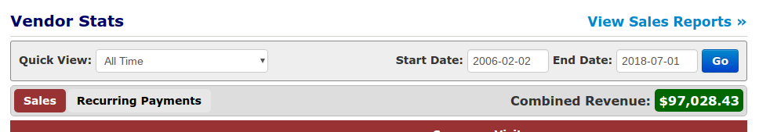
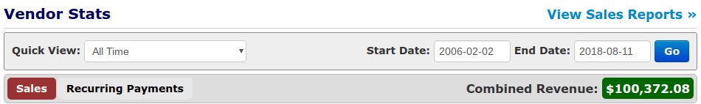
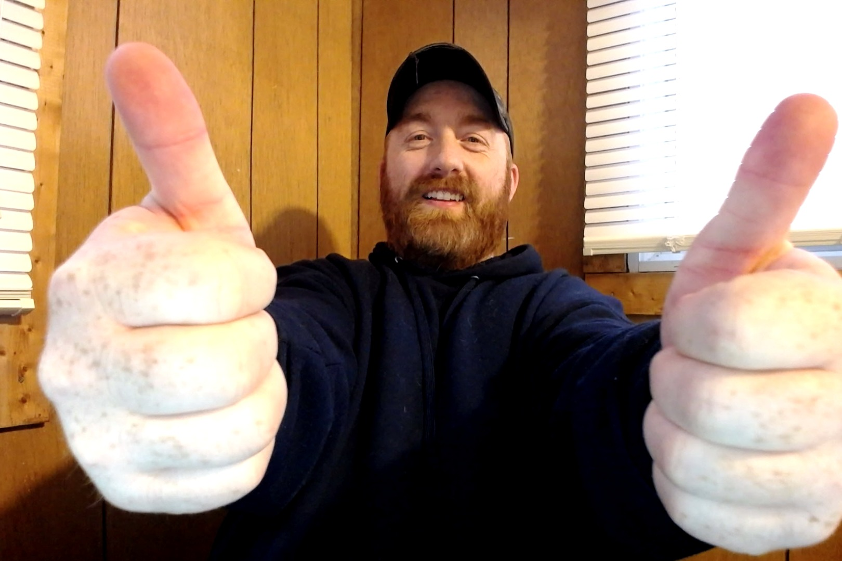
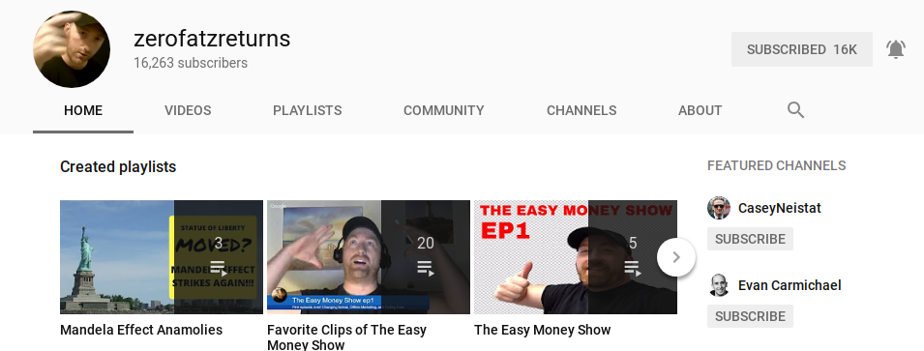
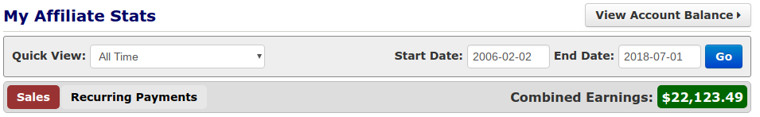
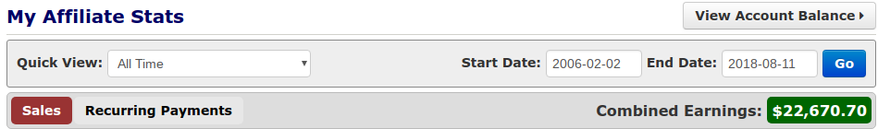
Kam Jennings
Notes:
Add trial closes here

Slide 9
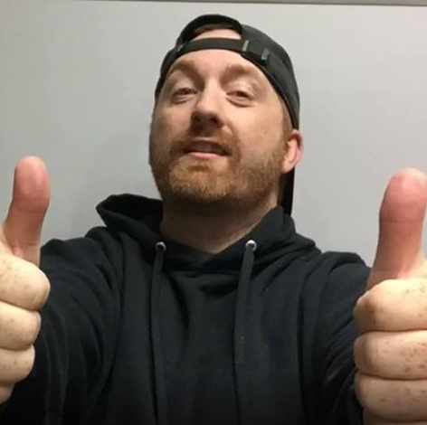
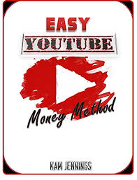
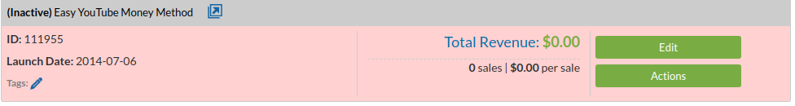
Kam Jennings
My First Product “Launch”

Slide 10
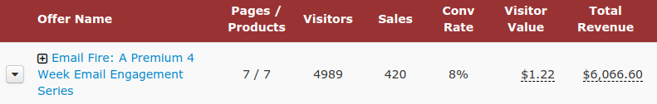

4 Years Later...

Slide 11
4 Years is too long...

Slide 12
I should have gotten help...

Slide 13
I don’t want you to be successful online in 4 years...

Slide 14
I want to see you achieve success in a matter of weeks.

Slide 15
Done A Lot Of Things Right…

Slide 16
Done A Lot Of Things WRONG…

Slide 17
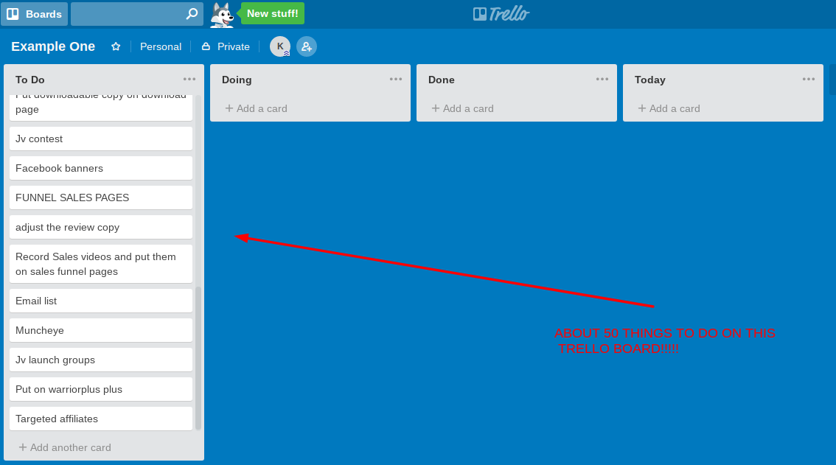
The Hard Way (Past 4 Years)
Research and Develop the product
Write sales letter or high converting VSL
Design and Put together a high converting sales funnel
Design and build all webpages
Get buy buttons in place and Automate the whole process
Drive highly targeted traffic to sales page
Write an engaging follow up email sequence
Have a lucrative back end offer in place to maximise profits
6 weeks!

Slide 18
I Discovered This HARD Way…
(You Get To Cheat And Get The Easy Way…)

Slide 19
Want The Easy Way That You can repeat this process?

Slide 20
The 3 Secrets…
Secret #1 – I’m going to show you how to ETHICALLY STEAL hours and hours worth of professional work that has produced thousands of dollars in revenue!
Secret #2 – How to copy a PROVEN sales funnel in less than 30 minutes!
Secret #3 – How to finally start getting laser targeted traffic to your sales pages for FREE!

Slide 21
Secret #1 – How to ETHICALLY STEAL hours and hours worth of professional work that has produced thousands of dollars in revenue!

Slide 22
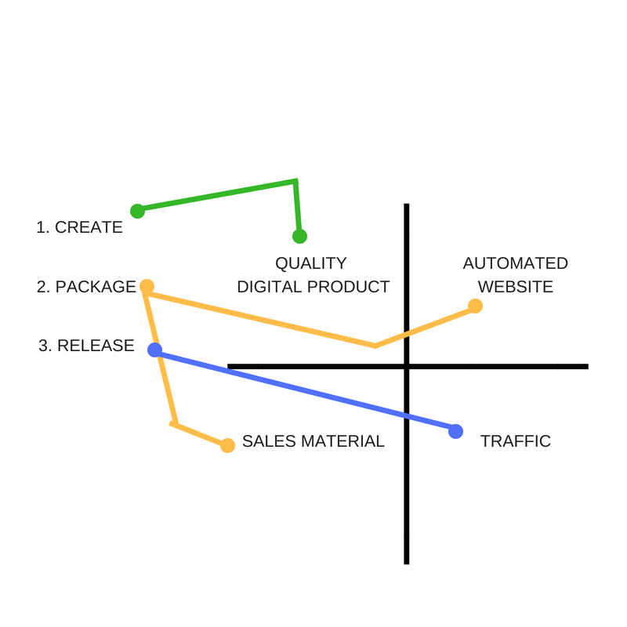
MY START...

Slide 23
It wasn’t enough...

Slide 24
I needed to add a few things...
Continuity programs
Funnels
High ticket programs
Strategic affiliate marketing

Slide 25
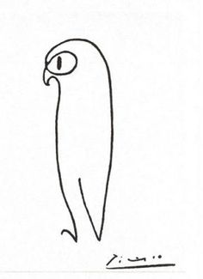
“Good artists copy, Great artists steal”
-Pablo Picasso
Notes:
Tell story about how I had reached a certain level doing it my own way, but to reach my first 5 figure launch I modeled someone elses way who was doing more successful than I was

Slide 26
A story of 2 product launches...

Slide 27

THE STORY OF OVERTURE
In 1998 Goto.com, a small startup (later Overture, now part of Yahoo!), created the pay per click search engine and advertising system and demo'd it at the TED conference.

Slide 28
THE STORY OF OVERTURE
It was not until October 2000 that Google offered its version of a pay per click advertising system--AdWords--allowing advertisers to create text ads for placement on the Google search engine.

Slide 29
THE STORY OF OVERTURE
Google is a $25 billion dollar company with most of its revenue from AdWords.

Slide 30
THE STORY OF OVERTURE
Overture was acquired by Yahoo for $1.6 billion.

Slide 31
THE STORY OF OVERTURE
As of August 2018
71.98% of searches were powered by Google
4.44% by Yahoo!
Notes:
I have to admit I am somewhat of an artist, I play guitar and write songs and I have to remind myself that modeling after success is truly a quicker way to accomplish things.

Slide 32
The bottom line here is that you can learn to do a lot of things on your own, doing it your way and kind of reinventing the wheel.

Slide 33
But you will move forward much faster and see a higher level of success quicker by modeling what is already working.

Slide 34
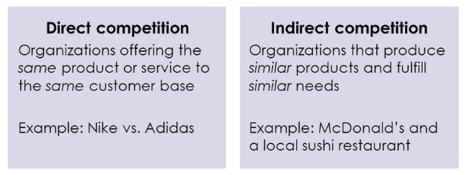
Two Types of Competition

Slide 35
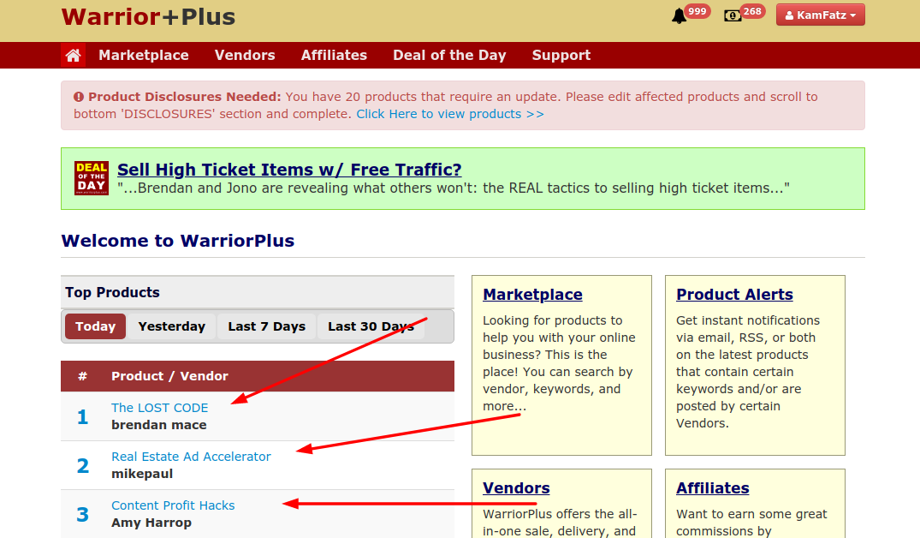
Step 1) Model your successful competitors (SP)

Slide 36
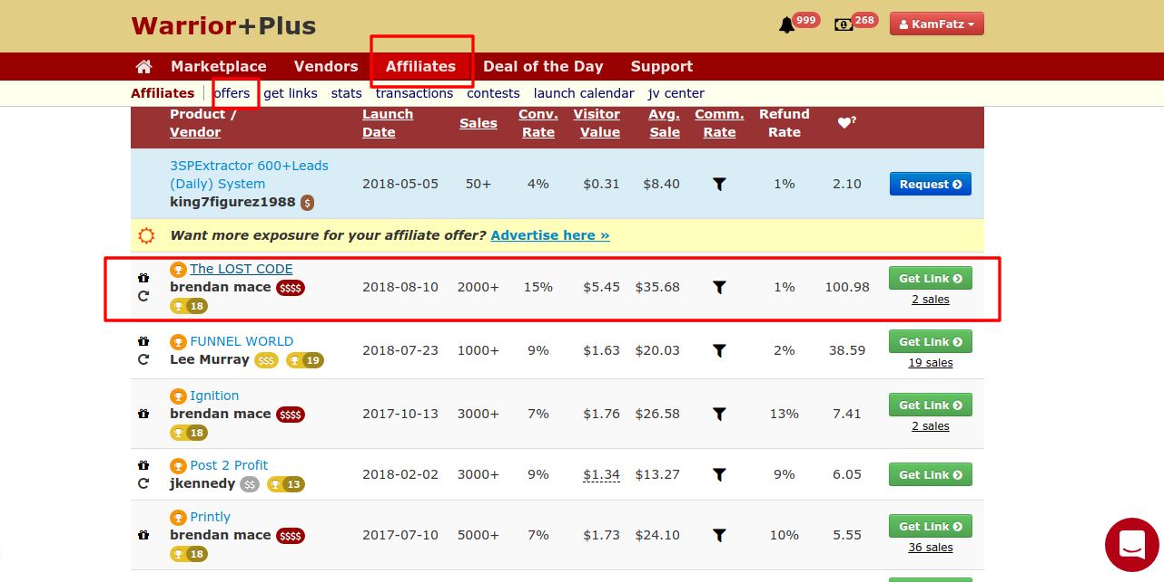
Step 2) Model your successful competitors (funnel)

Slide 37
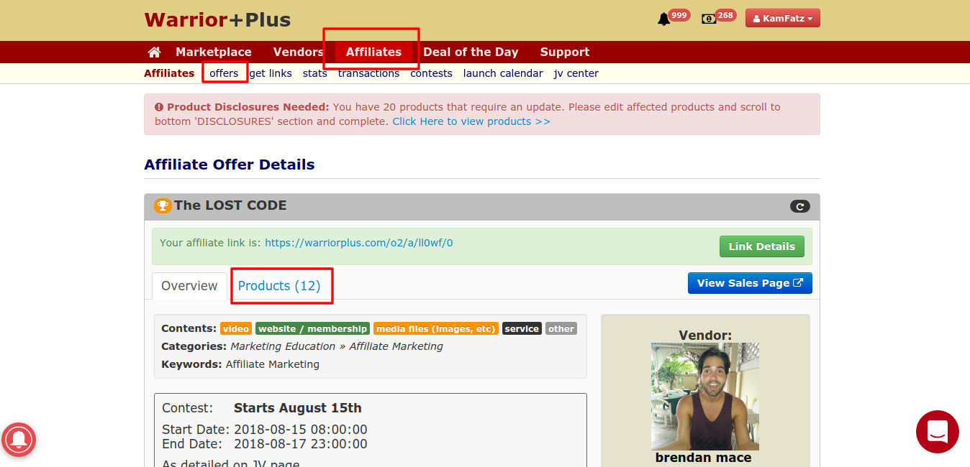
Step 2) Model your successful competitors (funnel)

Slide 38
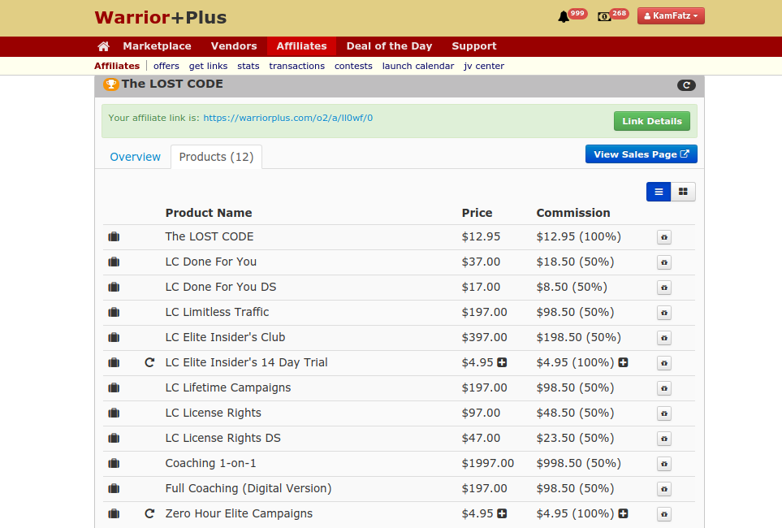
Step 2) Model your successful competitors (funnel)
Notes:
Now a smart entrepreneur knows when it’s time to invest some money and figure out what's going on in there.

Slide 39
Step 3) Once you have the sales page and funnel converting well, adjust for improvement

Slide 40
Who does this work for?
This works for all types of businesses!

Slide 41
Secret #2 – How to COPY a PROVEN sales funnel in less than 30 minutes!

Slide 42
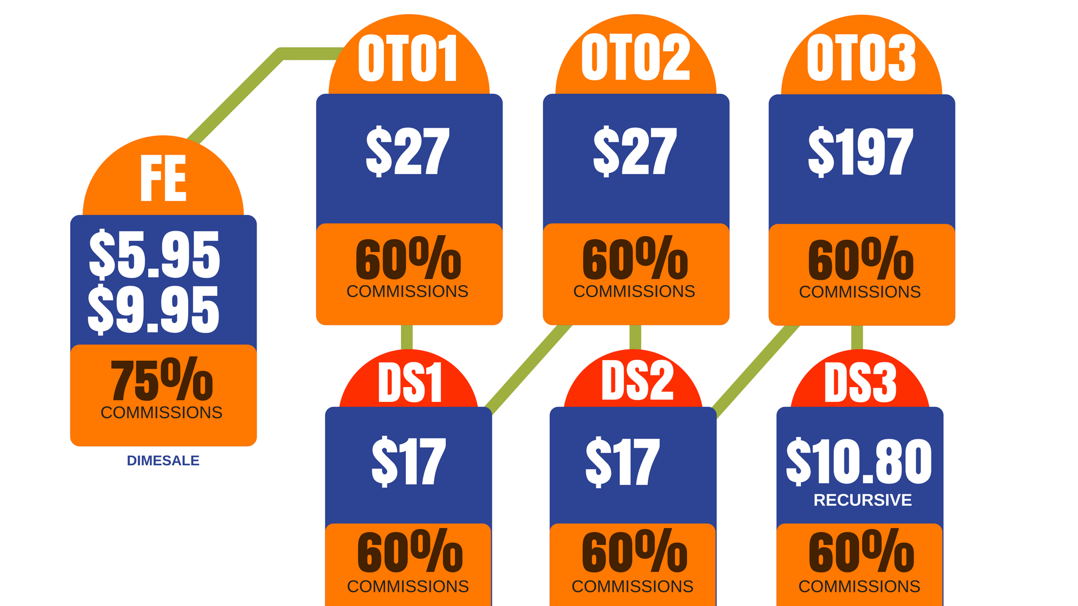
Map out the entire funnel and model each page aesthetically and stylistically

Slide 43
What you would need to do...
Get a page builder
Figure out how to use it
Model that winning sales page
Write your own sales letter
Model all the funnel pages
Set up an email list and follow up sequence for product
A bunch more things...

Slide 44
I used to teach students 1 on 1 how to do ALL of those things and much more so that they too could run a successful digital publishing business...

Slide 45
But do you know what started happening?

Slide 46
They started giving up!

Slide 47
Even after earning money online and seeing the potential...

Slide 48
I would still have people giving up!

Slide 49
Not all, but definitely a few...

Slide 50
...and do you know what the reason was?

Slide 51
Just too much work for the modest payoff in the beginning and will take too long to build up...

Slide 52
See those students weren’t even interested in spending 12 months building their business up.

Slide 53
They wanted BIG results faster. Much faster.

Slide 54
And look at first I have to admit, I was a little angry and frustrated...

Slide 55
...I mean building a real sustainable business takes time and effort...

Slide 56
But what I learned a long time ago is that it’s important to take responsibility for problems so that I am free to find solutions

Slide 57
The minute you start blaming everyone else, is the minute you are a victim.

Slide 58
Victims do not win.

Slide 59
So how could I speed up the learning curve for my students?

Slide 60
How could I get them earning more money faster?

Slide 61
And then it hit me...

Slide 62
Why not just let them use what I have already created and proven to work?

Slide 63
So I created a BRAND NEW Digital Coaching Package...

Slide 64


Slide 65
EC IM JUPSTART:
My Page Builder installed for you
Access to all my most successful VSL templates
Access to all my most successful sales page templates
Access to my most successful sales funnel template
My membership plugin installed for you
In depth video training on exactly how to set up an entire digital publishing business complete with high ticket sales and continuity program
Much more...

Slide 66
What used to take weeks can now be accomplished in a matter of days...

Slide 67
...not simply modeling what I do...

Slide 68
...but instead, literally taking the exact templates of what I did...

Slide 69
...uploading them and adjusting them to your liking.
Notes:
How cool would that be? To just take someone elses proven work and upload it right to your website and adjust it for your thing and just start selling? Yeah, really cool and that’s why I want to do do this for you guys. IM Jumpstart is all about getting started fast and winning!

Slide 70
It is honestly, a game changer.
Notes:
How cool would that be? To just take someone elses proven work and upload it right to your website and adjust it for your thing and just start selling? Yeah, really cool and that’s why I want to do do this for you guys. IM Jumpstart is all about getting started fast and winning!

Slide 71
Secret #3 – How to finally start getting laser targeted traffic to your sales pages for FREE!

Slide 72
So there are a lot of traffic sources out there...

Slide 73
...that appear to make great sense until you start using them...

Slide 74
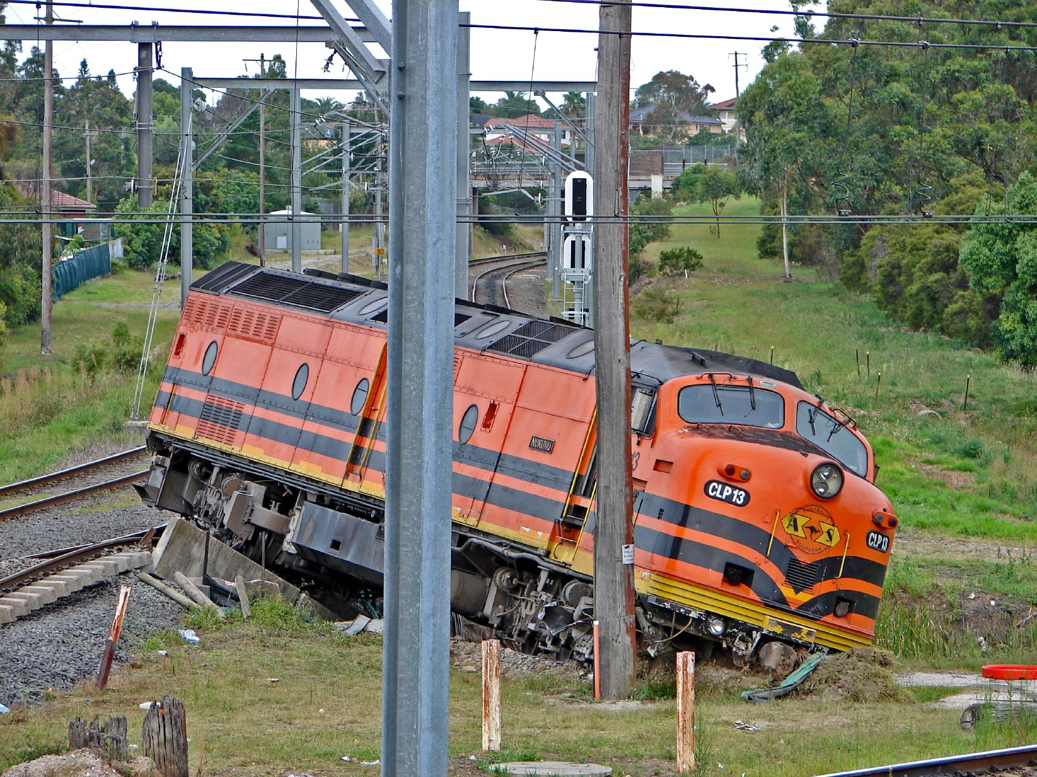
...and then things start going off the rails in one way or another.

Slide 75
What you will find is that driving traffic splits up into three categories...

Slide 76
1
2
FREE
TRAFFIC
PAID
TRAFFIC

Slide 77
FASTEST WAY TO SEE SUCCESS ONLINE...
3
INFLUENCER
TRAFFIC

Slide 78
Influencer traffic is great because...
The traffic is extremely targeted and will buy at a much higher rate.
When the customers hit your email list it will be as buyers and will be extremely receptive to other offers without the need to build massive amounts of trust and good will.

Slide 79
The average conversion rate on a paid offer online is roughly 1% to 5%

Slide 80
That’s not the case with influencer traffic.

Slide 81
This traffic has been referred to you by someone who has already build a reputation with the traffic...

Slide 82
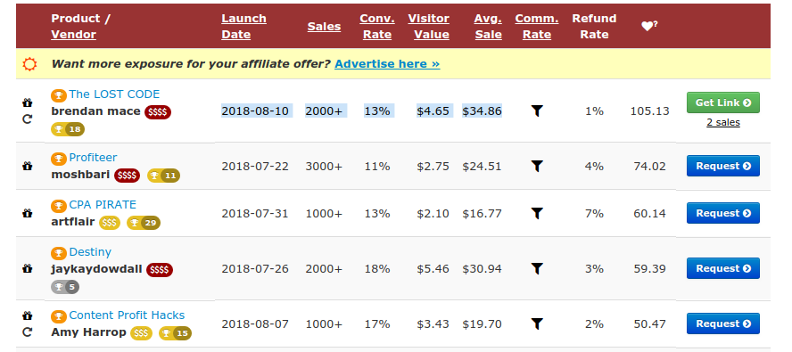

Slide 83
So how do you get this influencer traffic?

Slide 84
Step 1) You need to find them
Let me show you how...

Slide 85
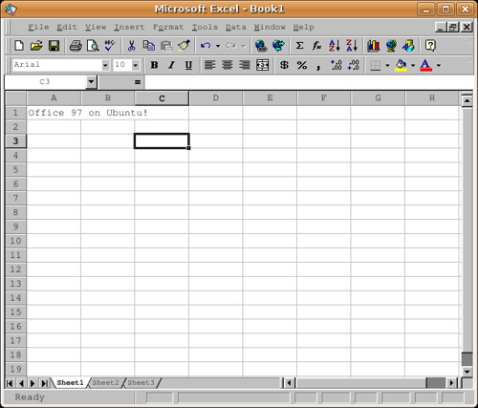
Step 2) You put a list of them together

Slide 86
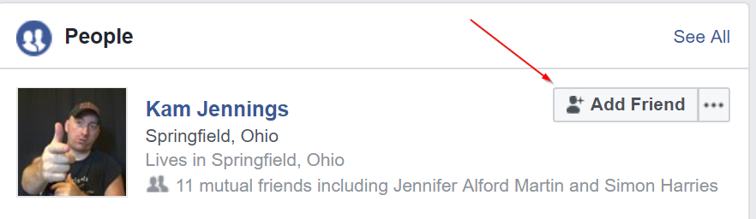
Step 3) Facebook friend them

Slide 87
Step 4) Start the networking process

Slide 88
Step 5) Let everybody know when you are going to launch a piece of paid content (at least 2 weeks before)

Slide 89
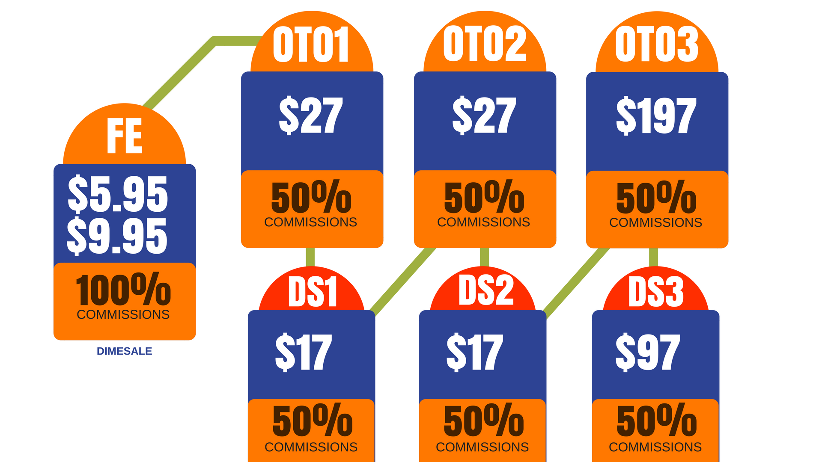
Step 6) Offer them amazing commission rates

Slide 90
The 3 Secrets…
Secret #1 – How to ETHICALLY STEAL hours and hours worth of professional work that has produced thousands of dollars in revenue!
Secret #2 – How to copy a PROVEN sales funnel in less than 30 minutes!
Secret #3 – How to finally start getting laser targeted traffic to your sales pages for FREE!

Slide 91
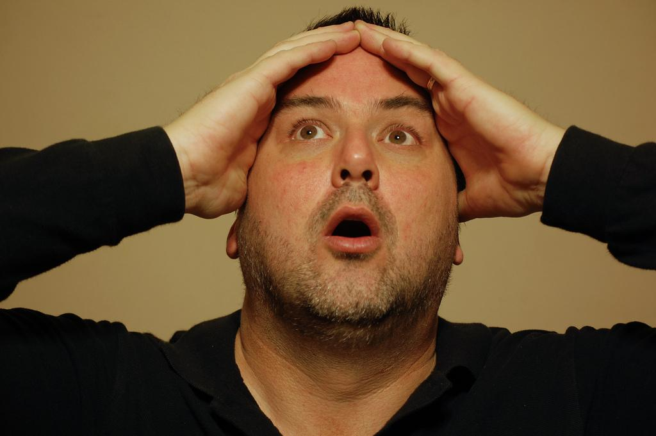
Let me ask you a question...
Notes:
Let me ask you a question. We’ve been talking for the last hour or so and honestly I can really get going and cover a lot of information quickly. I totally get that. How many of you guys would be interested in continuing this more in depth and really digging deep and learning all the tricks and strategies of running this business? Well if you don’t mind, I’d like to offer you a special package that I have put together today.

Slide 93
What You’re Gonna Get...
Notes:
Let me ask you a question. We’ve been talking for the last hour or so and honestly I can really get going and cover a lot of information quickly. I totally get that. How many of you guys would be interested in continuing this more in depth and really digging deep and learning all the tricks and strategies of running this business? Well if you don’t mind, I’d like to offer you a special package that I have put together today.

Slide 94
EC IM JUPSTART:
7 Module IM Jumpstart Master Class of In depth video training on exactly how to set up an entire digital publishing business complete with high ticket sales and continuity program ($997)
7 Weeks of Group Coaching from me personally ($997)
My (thrive architect) Page Builder installed for you ($67+$197 for install)
Downloadable Access to all my most successful thrive architect sales page templates($197)
Total Value = $2455

Slide 95
All of us have disposable income…

Slide 96
Most of you guys get your paycheck each month. And a % of that goes towards movies and things like that…

Slide 97
and I’m not asking you guys to go into debt with this at all…

Slide 98
What I’m asking you to do is…

Slide 99
Take your disposable income...

Slide 100
...and instead of blowing it on stuff that's just going to be there and then just kinda fade away… and you’re gonna lose it…

Slide 101
I’m asking you to make an investment in yourself… Because the money you put into this is going to turn into even more money…

Slide 102
You guys have read the book, Rich Dad Poor Dad?

Slide 103
In that book he talks about the difference between assets and liabilities…

Slide 104
He said, the poor people buy liabilities (cars, boats, etc…)

Slide 105
They buy things where you put money in, and then the money disappears…

Slide 106
Rich people put their money into investments… Things that actually turn into more money…

Slide 107
So all I’m asking you to do is divert some of your disposable income into an investment, as opposed to something that's going to take money away from you”

Slide 108
EC IM JUPSTART:
7 Module IM Jumpstart Master Class of In depth video training on exactly how to set up an entire digital publishing business complete with high ticket sales and continuity program ($997)
7 Weeks of Group Coaching from me personally ($997)
My (thrive architect) Page Builder installed for you ($67+$197 for install)
Downloadable Access to all my most successful thrive architect sales page templates($197)
Access to all my most successful VSL templates ($197)
Access to my most successful sales funnel template ($197)
Total Value = $2849

Slide 109
Every two weeks you get a paycheck…

Slide 110
And the cool thing about it, is you get that paycheck, you go out and pay your bills, then you have your disposable income…

Slide 111
then you spend that money on stuff and the money disappears…

Slide 112
But what happens 2 weeks later? You get paid again! That money replenishes.

Slide 113
And the cool thing about money, is that it ALWAYS replenishes…

Slide 114
Every 2 weeks it comes back again… coming back again. over and over and over again, right?

Slide 115
Now let me ask you a question…

Slide 116
Does that happen with your time too?

Slide 117
When you miss your daughter’s soccer game because you’re at your office… do you get that time back?

Slide 118
No you don’t huh? isn’t that weird? Money replenishes itself every 2 weeks, but your time never comes back.

Slide 119
So what I’m asking you to do is take that asset that's going to keep replenishing itself every 2 weeks, and invest in something that’s going to save you a ton of time.

Slide 120
You can go do all the stuff I did… learn how to launch a ton of products, build funnels, sales pages, membership programs and high ticket offers...

Slide 121
…you can go do all that stuff that takes a lot of time, money, and energy…

Slide 122
But what i’m trying to do with this package that I’ve created for you guys… is I’m just trying to save you a bunch of time...

Slide 123
And because you can’t get your time back…

Slide 124
I’m asking you to take money (which is replenishable — in 2 weeks you’re going to have that money back anyway, so it doesn’t even matter… )

Slide 125
…and invest it into something that's going to help you do that, and it’s going to save you a ton of time.”

Slide 126
This works in any market…

Slide 127
You’re welcome to go learn this stuff on your own… But man, that time that you waste testing and trial and error, and all the ups and downs…

Slide 128
that time doesn’t come back…

Slide 129
You’re money’s going to be back in 2 weeks… it keeps coming back like clockwork…

Slide 130
Even if you lose your job, guess what the government’s going to replenish it for you… it just keeps coming back…

Slide 131
So take some of that money, and instead of blowing it on stuff where it disappears, invest into this special package that I’ve put together just for you…

Slide 132
EC IM JUPSTART:
7 Module IM Jumpstart Master Class of In depth video training on exactly how to set up an entire digital publishing business complete with high ticket sales and continuity program ($997)
7 Weeks of Group Coaching from me personally ($997)
My (thrive architect) Page Builder installed for you ($67+$197 for install)
Downloadable Access to all my most successful thrive architect sales page templates($197)
Access to all my most successful VSL templates ($197)
Access to my most successful sales funnel template ($197)
My membership plugin installed for you ($27+197)
Monthly live group mentor calls ($997)
Total Value = $4070

Slide 133
I want to ask you guys a question…

Slide 134
A lot of you guys… You’ve probably been on these type of webinars on the past, right?

Slide 135
You get excited and fired up, and then what happens the next day? Probably nothing for most of you guys…

Slide 136
And that’s sad to me because I just showed you the exact system I used to take a simple little publishing business to 100k…

Slide 137
and you’re going to go home tomorrow and do nothing…

Slide 138
And the reason for that is because old habits are hard to break…

Slide 139
So unless you do something right here right now, you’ll go back to your office tomorrow and fall back into those exact same habits…

Slide 140
The ONLY way that you’re going to be successful is if we figure out a way to break that habit right now.

Slide 141
And the way you’re going to break that habit is by investing in this course…

Slide 142
and then now I can work closer with you, and give you all the tools you need to break that habit so you can become successful…

Slide 143
If you don’t do that, you’re going to slide back into the exact same habit, and everything we did here for the last hour will be completely useless to you because you’ll slide back into the old habit.

Slide 144
The only way to break that habit is to invest right now…

Slide 145
So now you have the tools to help you break that habit and take your business to the next level.

Slide 146
EC IM JUPSTART:
7 Module IM Jumpstart Master Class of In depth video training on exactly how to set up an entire digital publishing business complete with high ticket sales and continuity program ($997)
7 Weeks of Group Coaching from me personally ($997)
My (thrive architect) Page Builder installed for you ($67+$197 for install)
Downloadable Access to all my most successful thrive architect sales page templates($197)
Access to all my most successful VSL templates ($197)
Access to my most successful sales funnel template ($197)
My membership plugin installed for you ($27+197)
Monthly live group mentor calls ($997)
My personal affiliate recruitment scripts ($97)
24 Hour Personal Email Access to me (1 yr) ($197)
Lifetime Access to EC Insider’s Club and my Product Vault ($997)
Total Value = $5067

Slide 147
I Had Two Choices…
First Option – Go Cheap As Possible And Try To Sell As Many As Possible… (It wouldn’t incentivize me to REALLY stack the value…)
Second Option – Requires A Little Higher Investment… (but in exchange I can devote more resources to guarantee your success)

Slide 148
Bonus #1
4 Master Class Replay Package
($291 Value)
NOTE: This Bonus For First 30 People Only

Slide 149
Bonus #2
PLR LIBRARY
($197 Value)
NOTE: This Bonus For First 20 People Only

Slide 150
What You’re Gonna Get…
- 7 Module IM Jumpstart Master Class of In depth video training on exactly how to set up an entire digital publishing business - - complete with high ticket sales and continuity program ($997)
- 7 Weeks of Group Coaching from me personally ($997)
- My (thrive architect) Page Builder installed for you ($67+$197 for install)
- Downloadable Access to all my most successful thrive architect sales page templates($197)
- Access to all my most successful VSL templates ($197)
- Access to my most successful sales funnel template ($197)
- My membership plugin installed for you ($27+197)
- Monthly live group mentor calls ($997)
- My personal affiliate recruitment scripts ($97)
- 24 Hour Personal Email Access to me (1 yr) ($197)
- Lifetime Access to EC Insider’s Club and my Product Vault ($997)
Bonus #1: 4 Master Class Replay Package (22 plus hours of in depth training) ($291 Value)
Bonus #2: PLR LIBRARY ($197 Value)
Total Value: $5,555

Slide 151
If All This Did Was…
Finally make your business profitable...Would It Be Worth it?
Give you the kick in the pants to finally get you moving...Would It Be Worth It?
Help you earn an extra 1k to 2k a month in passive income...Would It Be Worth It?

Slide 152
What’s an extra 1k to 2k a Month in Passive Income Worth To You?
$5k? $10k? $25k? More…?
How Much Would You Pay One Time To Get
Thousands in passive income rolling in every month?

Slide 153
If you were to make ONLY $1,000 a month ($12,000 a year) with IM Jumpstart...
Would it make sense to pay me JUST $5k ONE TIME to help set this up for you?
(Then everything after month 5 is just PURE PROFIT!)

Slide 154
You Can See Why It’s
A Good Deal At $5,000

Slide 155
But let’s make it better...

Slide 156
Not $5,000...

Slide 157
Not $4,000...

Slide 158
Not $3,000...

Slide 159
No I want this under 2k for you...

Slide 160
Because You Are Special…

Slide 161

Get Started NOW For Just
$1997 Today
Click The Button Below

Slide 162

Bonus #3
LIFETIME SUPER 20 CLUB ACESS
($1,997 Value)
NOTE: This Bonus For First 10 People Only

Slide 163
Get Started NOW For Just
$1997 Today
Click The Button Below

Slide 164
Now YOU Had Two Choices…
First Option – Do Nothing, and NOT Take This Leap Of Faith
Second Option – Pony Up This Small investment Today (compared to all the value you’ll get in return, and just give it a shot!)

Slide 165
NO REFUNDS
Epic Conversions does not give refunds on The Epic Conversions IM Jumpstart Program. This is an exclusive package that offers massive benefit to its members in the way of in depth training, plr rights on products, group coaching, individual help, dfy installations, high ticket funnel opportunities and a massive amount of time invested on my part to help insure your individual success. Please make sure you know what you are buying before you purchase.
You can ask me any questions you have about EC IM Jumpstart before purchasing at kamjenningspro@gmail.com

Slide 166


The Tale of Two People…
Get Started Now: Click The Buy Button Below

Slide 167
What You’re Gonna Get…
- 7 Module IM Jumpstart Master Class of In depth video training on exactly how to set up an entire digital publishing business - - complete with high ticket sales and continuity program ($997)
- 7 Weeks of Group Coaching from me personally ($997)
- My (thrive architect) Page Builder installed for you ($67+$197 for install)
- Downloadable Access to all my most successful thrive architect sales page templates($197)
- Access to all my most successful VSL templates ($197)
- Access to my most successful sales funnel template ($197)
- My membership plugin installed for you ($27+197)
- Monthly live group mentor calls ($997)
- My personal affiliate recruitment scripts ($97)
- 24 Hour Personal Email Access to me (1 yr) ($197)
- Lifetime Access to EC Insider’s Club and my Product Vault ($997)
Bonus #1: 4 Master Class Replay Package (22 plus hours of in depth training) ($291 Value)
Bonus #2: PLR LIBRARY ($197 Value)
Bonus #3: Lifetime Access to Super 20 Club ($1997 Value)
Total Value: $7,552

Slide 168
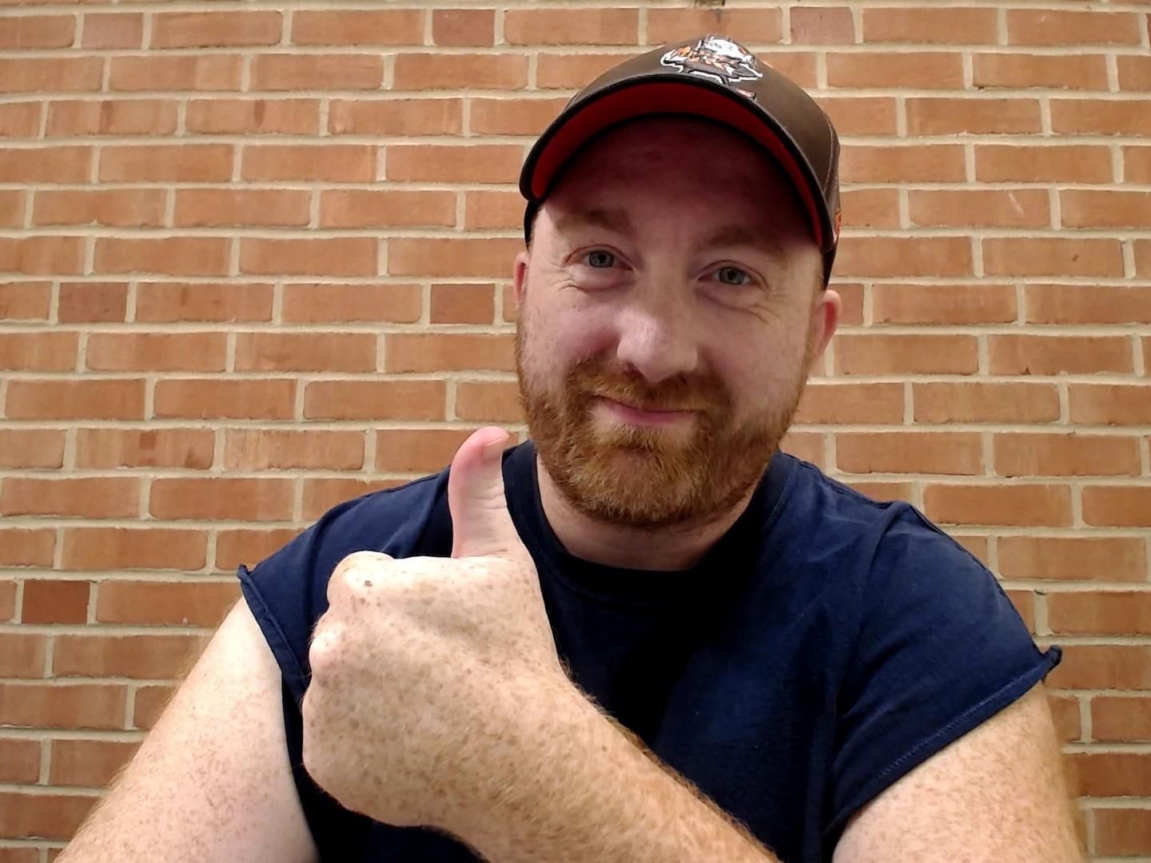
I’m Nothing Special…
I am not good at technical stuff
I don’t have some kind of special super power
I’m not an amazing writer
I definitely don’t “dress for success”
I don’t have endless amounts of time
But I can STILL run this business!

Slide 169
What You’re Gonna Get…
- 7 Module IM Jumpstart Master Class of In depth video training on exactly how to set up an entire digital publishing business - - complete with high ticket sales and continuity program ($997)
- 7 Weeks of Group Coaching from me personally ($997)
- My (thrive architect) Page Builder installed for you ($67+$197 for install)
- Downloadable Access to all my most successful thrive architect sales page templates($197)
- Access to all my most successful VSL templates ($197)
- Access to my most successful sales funnel template ($197)
- My membership plugin installed for you ($27+197)
- Monthly live group mentor calls ($997)
- My personal affiliate recruitment scripts ($97)
- 24 Hour Personal Email Access to me (1 yr) ($197)
- Lifetime Access to EC Insider’s Club and my Product Vault ($997)
Bonus #1: 4 Master Class Replay Package (22 plus hours of in depth training) ($291 Value)
Bonus #2: PLR LIBRARY ($197 Value)
Bonus #3: Lifetime Access to Super 20 Club ($1997 Value)
Total Value: $7,552

Slide 170
The First 10 People…
Lifetime Access to The Super 20 Club
($1,997 Value)

Slide 171
Get Started NOW For Just
$1997 Today
Click The Button Below

