Slide 1
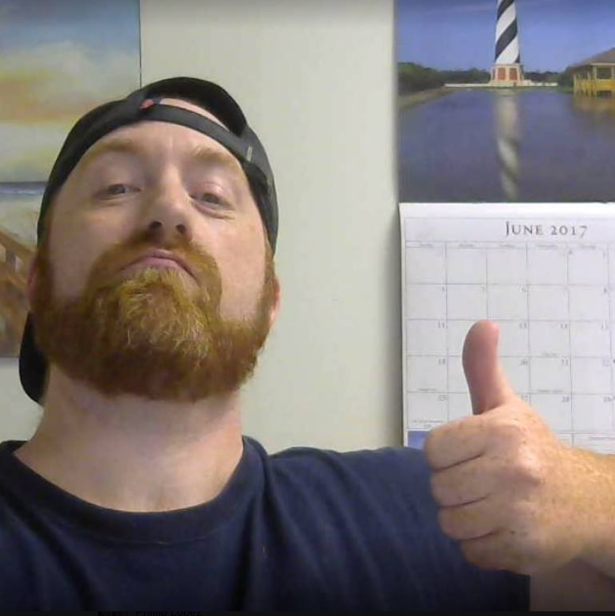
Hey! Kam Jennings here…

Slide 2
I want to show...

Slide 3
Here’s the problem...

Slide 4
Agitate problem...

Slide 5
Educate on problem...

Slide 6
MIX IN PROOF OF WHY YOU SHOULD LISTEN TO ME

Slide 7
AGITATE PROBLEM MORE...

Slide 8
But I know the solution...

Slide 9
Educate on the system and the moving parts...

Slide 10
Solution

Slide 11
Educate on loops in email sequences

Slide 12
A system like that will allow you to measure engagement and rapport with list and adjust based on performance...

Slide 13
Solution

Slide 14
Why?

Slide 15
I’ll tell you one reason why...

Slide 16
They don’t have time to really learn how to do it the right way.

Slide 17
The tools required to run an online business can be expensive if you aren’t making any money...

Slide 18
...and can have you throwing in the towel pretty quick...

Slide 19
I guess that’s why more than 90% of all Internet business start-ups end in failure within the
first 120 days.

Slide 20
I do not think that will be your fate though...

Slide 21
I’m about to give you all the time you need to figure this thing out...

Slide 22
I want to show how to get all the tools you need to run your online business…
...and how to get them for free.

Slide 23
And while we are at it...

Slide 24
I want to show you simple methods to produce lead magnets and products in lightning speed.

Slide 25
On top of that I want to walk you through how to very quickly write fast effective copy that gets results in email and on sales pages.

Slide 26
I am going to prove to you that ANYONE with a sheer force of will can create a successful online business that gets attention, builds audience, and makes you money.

Slide 27
You’re not going to need any experience to do this

Slide 28
You’re not going to need any experience to do this
You don’t need a million dollar camera

Slide 29
You’re not going to need any experience to do this
You don’t need a million dollar camera
You don’t have to be some kind of internet marketing GURU with a million products under your belt

Slide 30
You’re not going to need any experience to do this
You don’t need a million dollar camera
You don’t have to be some kind of video marketing GURU with a million videos under your belt
You don’t have to have a bunch of knowledge about SEO or Quantum Physics.

Slide 31
You’re not going to need any experience to do this
You don’t need a million dollar camera
You don’t have to be some kind of video marketing GURU with a million videos under your belt
You don’t have to have a bunch of knowledge about SEO or Quantum Physics.
You’re not going to need expensive software

Slide 32
You’re not going to need any experience to do this
You don’t need a million dollar camera
You don’t have to be some kind of video marketing GURU with a million videos under your belt
You don’t have to have a bunch of knowledge about SEO or Quantum Physics.
You’re not going to need expensive software
And you’re not going to have to dedicate every waking moment of your life to this either…

Slide 33
Here’s a little fact about internet marketing for you...

Slide 34

Every action people have to take requires a decision. At most decision points, more than 50% of your audience (usually more like 80-99%) opts out.

Slide 35
You heard it right...50%

Slide 36
THAT’S INSANE!!

Slide 37
What it means is that it takes time and practice to get this stuff right.

Slide 38
Bruce Lee himself could teach you Kung Fu...

Slide 39
...and let’s face it...

Slide 40
You’re still going to get your butt kicked a few times.

Slide 41
It’s no different with learning to make money online or becoming a digital marketer...

Slide 42
It’s takes a little time to get good at something...

Slide 43
What I am offering here is time with no expense...

Slide 44
NO tricks

Slide 45
No tricks.
No expensive tools necessary.

Slide 46
No Tricks.
No expensive coaching necessary.
No college degree needed.

Slide 47
What it means is that the new barrier to success is now what it always should have been…

Slide 48
A simple will to win.

Slide 49
The fact is I’m just a normal guy who committed to making this online thing work.

Slide 50
When I first started I really didn’t know anything about the power of sales funnels or email marketing or list building or any of that...

Slide 51
I sure as heck didn’t know that this thing was going to grow to a scale that could support my family…

Slide 52
And that is where many of you guys have a serious advantage.

Slide 53
You already get the power of starting a business online and what you can do with it.

Slide 54
Your problem is you have no confidence in what to do or if it will even work.

Slide 55
And look this is my job. I’ve done a lot of research on it. I get that many of you:
Have spent money on multiple courses and failed to take action

Slide 56
And look this is my job. I’ve done a lot of research on it. I get that many of you:
Have spent money on multiple courses and failed to take action
Have spent money on multiple courses that just plain did not work

Slide 57
And look this is my job. I’ve done a lot of research on it. I get that many of you:
Have spent money on multiple courses and failed to take action
Have spent money on multiple courses that just plain did not work
Get bogged down with the technical details

Slide 58
And look this is my job. I’ve done a lot of research on it. I get that many of you:
Have spent money on multiple courses and failed to take action
Have spent money on multiple courses that just plain did not work
Get bogged down with the technical details
Have tried and failed in the past

Slide 59
And look this is my job. I’ve done a lot of research on it. I get that many of you:
Have spent money on multiple courses and failed to take action
Have spent money on multiple courses that just plain did not work
Get bogged down with the technical details
Have tried and failed in the past
Are intimidated by recurring monthly charges from places like clickfunnels

Slide 60
And look this is my job. I’ve done a lot of research on it. I get that many of you:
Have spent money on multiple courses and failed to take action
Have spent money on multiple courses that just plain did not work
Get bogged down with the technical details
Have tried and failed in the past
Are intimidated by recurring monthly charges from places like clickfunnels
Are losing money on autoresponders that are not making you money but you were told you needed.

Slide 61
And look this is my job. I’ve done a lot of research on it. I get that many of you:
Have spent money on multiple courses and failed to take action
Have spent money on multiple courses that just plain did not work
Get bogged down with the technical details
Have tried and failed in the past
Are intimidated by recurring monthly charges from places like clickfunnels
Are losing money on autoresponders that are not making you money but you were told you needed.
Can’t seem to get started with anything

Slide 62
And look this is my job. I’ve done a lot of research on it. I get that many of you:
Have spent money on multiple courses and failed to take action
Have spent money on multiple courses that just plain did not work
Get bogged down with the technical details
Have tried and failed in the past
Are intimidated by recurring monthly charges from places like clickfunnels
Are losing money on autoresponders that are not making you money but you were told you needed.
Can’t seem to get started with anything
Can’t get your focus under control enough to move forward with anything

Slide 63
And look this is my job. I’ve done a lot of research on it. I get that many of you:
Have spent money on multiple courses and failed to take action
Have spent money on multiple courses that just plain did not work
Get bogged down with the technical details
Have tried and failed in the past
Are intimidated by recurring monthly charges from places like clickfunnels
Are losing money on autoresponders that are not making you money but you were told you needed.
Can’t seem to get started with anything
Can’t get your focus under control enough to move forward with anything
Just feel like it’s too much work to mess with…

Slide 64
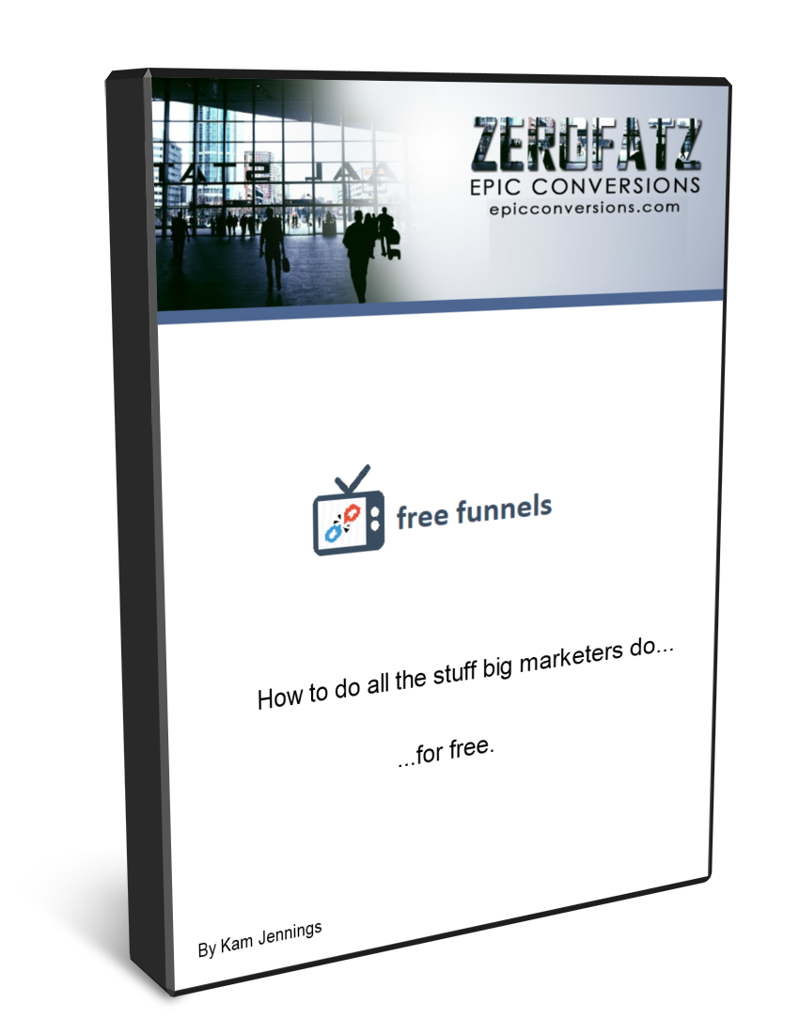
Again…that’s where I come it.

Slide 65
free funnels is divided into 4 simple modules covering the 12 most important subjects of your LIFE!

Slide 66
Ok...maybe not your life but...

Slide 67
they are pretty damn important...

Slide 68
What are they?

Slide 69
Creating Paid products that actually make money

Slide 70
Creating Paid products that actually make money
Creating Lead magnets that actually get opt-in’s

Slide 71
Creating Paid products that actually make money
Creating Lead magnets that actually get opt-in’s
Free website and page builder set up

Slide 72
Creating Paid products that actually make money
Creating Lead magnets that actually get opt-in’s
Free website and page builder set up
Building OTO’s and Downsells that convert

Slide 73
Creating Paid products that actually make money
Creating Lead magnets that actually get opt-in’s
Free website and page builder set up
Building OTO’s and Downsells that convert
Effective free Squeeze pages, Download Pages and Thank you Pages

Slide 74
Creating Paid products that actually make money
Creating Lead magnets that actually get opt-in’s
Free website and page builder set up
Building OTO’s and Downsells that convert
Effective free Squeeze pages, Download Pages and Thank you Pages
Effective Sales pages

Slide 75
Creating Paid products that actually make money
Creating Lead magnets that actually get opt-in’s
Free website and page builder set up
Building OTO’s and Downsells that convert
Effective free Squeeze pages, Download Pages and Thank you Pages
Effective Sales pages
Effective Security Log-in Pages

Slide 76
Creating Paid products that actually make money
Creating Lead magnets that actually get opt-in’s
Free website and page builder set up
Building OTO’s and Downsells that convert
Effective free Squeeze pages, Download Pages and Thank you Pages
Effective Sales pages
Effective Security Log-in Pages
Free autoresponder set up

Slide 77
Creating Paid products that actually make money
Creating Lead magnets that actually get opt-in’s
Free website and page builder set up
Building OTO’s and Downsells that convert
Effective free Squeeze pages, Download Pages and Thank you Pages
Effective Sales pages
Effective Security Log-in Pages
Free autoresponder set up
How to write effective autoresponder sequences super fast

Slide 78
Creating Paid products that actually make money
Creating Lead magnets that actually get opt-in’s
Free website and page builder set up
Building OTO’s and Downsells that convert
Effective free Squeeze pages, Download Pages and Thank you Pages
Effective Sales pages
Effective Security Log-in Pages
Free autoresponder set up
How to write effective autoresponder sequences super fast
How to set up your funnel for free

Slide 79
Creating Paid products that actually make money
Creating Lead magnets that actually get opt-in’s
Free website and page builder set up
Building OTO’s and Downsells that convert
Effective free Squeeze pages, Download Pages and Thank you Pages
Effective Sales pages
Effective Security Log-in Pages
Free autoresponder set up
How to write effective autoresponder sequences super fast
How to set up your funnel for free
How to move your email subscribers from list to list easily on automation

Slide 80
Creating Paid products that actually make money
Creating Lead magnets that actually get opt-in’s
Free website and page builder set up
Building OTO’s and Downsells that convert
Effective free Squeeze pages, Download Pages and Thank you Pages
Effective Sales pages
Effective Security Log-in Pages
Free autoresponder set up
How to write effective autoresponder sequences super fast
How to set up your funnel for free
How to move your email subscribers from free lists to paid lists easily on automation
How to set up all your legal pages easily for free

Slide 81
Not only am I going to give you the FREE blueprint to WIN on the Internet...

Slide 82
I AM GOING TO GIVE YOU 2 WEBINAR REPLAYS WHERE I TALK ABOUT MY FAVORITE FREE TRAFFIC SOURCES FOR YOUR FUNNEL

Slide 83
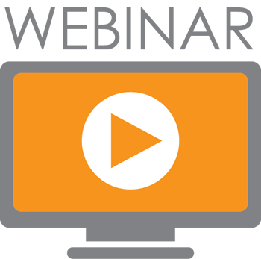

That’s over 2 hours of pure no fill content where I speak about my favorite places to drive free traffic…

Slide 84
I don’t just want to show you the strategies. I don’t just want to help you put it all together for free. I want to show you how to get traffic to it as well.

Slide 85
Listen…
The stuff I teach inside free funnels IS extremely powerful strategy that has worked time and time again.

Slide 86
What’s new is now you’ll know how to do all of it…
...for free.

Slide 87
It’s the kind of option I never had when I first got started.

Slide 88
It would be fair to charge $997 for this exact winning blueprint.

Slide 89
I know the value of what I teach and what I do. I know how important mastering this is. I also know what it means to be able to do it for free. I could go on and on…

Slide 90
I’m not trying to bleed you dry on this though.

Slide 91
I want you to win. Let’s make it easy.

Slide 92
You’re not paying $997 for this.

Slide 93
Not $497…

Slide 94
Not even $97…
And yeah that puts me square in the territory of putting in more work than what I will get back from teaching you this stuff.

Slide 95
I don’t care.

Slide 96
I’m starting this course at $7 bucks.

Slide 97
It’s a launch week special.

Slide 98
After that I’m setting the course at $27. Still an incredible deal, just not launch week incredible.

Slide 99
Now look, in a moment I’m going to give you a call to action…

Slide 100
I want you to invest in your business here.
What I offer you is no trick. This is no mere gimmick.

Slide 101
I am going to explain step by step exactly what I do and how to do it without having the expenses that go along with it...

Slide 102
AND I am going to give you 2 webinar replays showing you EXACTLY how to drive free traffic to the whole thing.

Slide 103
Building a rock solid business on the internet when you are living directly in the middle of the information age is a no brainer.

Slide 104
I am going to leave free funnels at $27 and if you look at it over the course of one year…

Slide 105
THAT’S LESS THAN .08 CENTS A DAY!!!

Slide 106
Would you be willing to invest .08 cents a day
over the course of one year for even a chance to vastly improve your life FOREVER?

Slide 107
I would. And have.

Slide 108
Take time to deliberate; but when the time for action arrives, stop thinking and go in.
Andrew Jackson

Slide 109
Today inside free funnels you’re going to be instantly getting the secrets to:
How to actually win online without spending a bunch of money on expensive tools

Slide 110
Today inside free funnels you’re going to be instantly getting the secrets to:
How to actually win online without spending a bunch of money on expensive tools
How to get a free a free pagebuilder and website set up

Slide 111
Today inside free funnels you’re going to be instantly getting the secrets to:
How to actually win online without spending a bunch of money on expensive tools
How to get a free a free pagebuilder and website set up
How to stop losing money on autoresponders that are not making you money but you were told you needed.

Slide 112
Today inside free funnels you’re going to be instantly getting the secrets to:
How to actually win online without spending a bunch of money on expensive tools
How to get a free a free pagebuilder and website set up
How to stop losing money on autoresponders that are not making you money but you were told you needed.
How to stop trying and failing!!!!

Slide 113
Today inside free funnels you’re going to be instantly getting the secrets to:
How to actually win online without spending a bunch of money on expensive tools
How to get a free a free pagebuilder and website set up
How to stop losing money on autoresponders that are not making you money but you were told you needed.
How to stop trying and failing!!!!
How to do everything without paying recurring monthly charges from places like clickfunnels

Slide 114
Today inside free funnels you’re going to be instantly getting the secrets to:
How to actually win online without spending a bunch of money on expensive tools
How to get a free a free pagebuilder and website set up
How to stop losing money on autoresponders that are not making you money but you were told you needed.
How to stop trying and failing!!!!
How to do everything without paying recurring monthly charges from places like clickfunnels
How to write fast effective email and sales copy

Slide 115
Today inside free funnels you’re going to be instantly getting the secrets to:
How to actually win online without spending a bunch of money on expensive tools
How to get a free a free pagebuilder and website set up
How to stop losing money on autoresponders that are not making you money but you were told you needed.
How to stop trying and failing!!!!
How to do everything without paying recurring monthly charges from places like clickfunnels
How to write fast effective email and sales copy
How to finally get started with something that works!

Slide 116
Today inside free funnels you’re going to be instantly getting the secrets to:
How to actually win online without spending a bunch of money on expensive tools
How to get a free a free pagebuilder and website set up
How to stop losing money on autoresponders that are not making you money but you were told you needed.
How to stop trying and failing!!!!
How to do everything without paying recurring monthly charges from places like clickfunnels
How to write fast effective email and sales copy
How to finally get started with something that works!
How to finally get your focus under control enough to move forward with something

Slide 117
Today inside free funnels you’re going to be instantly getting the secrets to:
How to actually win online without spending a bunch of money on expensive tools
How to get a free a free pagebuilder and website set up
How to stop losing money on autoresponders that are not making you money but you were told you needed.
How to stop trying and failing!!!!
How to do everything without paying recurring monthly charges from places like clickfunnels
How to write fast effective email and sales copy
How to finally get started with something that works!
How to finally get your focus under control enough to move forward with something
And how to stop feeling like it’s too much work to mess with…because we are taking this step by step!

Slide 118
In addition to that you're also going to get instant access to
2 WEBINAR REPLAYS WHERE I TALK ABOUT MY FAVORITE FREE TRAFFIC SOURCES FOR YOUR FUNNEL!
(previously only available to my coaching students)

Slide 119
I want you to click the button below and pick up free funnels

Slide 120
I’ll give you a few seconds to think about that...

Slide 121
5

Slide 122
4

Slide 123
3

Slide 124
2

Slide 125
1

Slide 126
Still not sure?

Slide 127
Consider this…

Slide 128
Let’s assume you’re going to buy this course at it’s highest price point of $27

Slide 129
If you used everything I am giving you today to build an online business that just ran without a paid autoresponder…

Slide 130
Your investment in this course will have paid for itself in 2 months.

Slide 131
At the end of 12 months you will have saved a total of:
$220 - $27 = $193

Slide 132
And I’m assuming you DON’T MAKE ANY MONEY YOUR FIRST YEAR AND You’re paid autoresponder was giving you your first month free!
$220 - $27 = $193

Slide 133
Don’t you think you could probably use free funnels to sell at least one product? I mean I’m going to teach you how to do everything...

Slide 134
If the answer is no then I think you need to take a long look in the mirror, because you’re selling yourself way too short.

Slide 135
But even if the answer is still no then guess what...you're still going to save a bunch of money. Because free funnels is going to eliminate all expenses for you.

Slide 136
The fact is if you had enough ambition and attention to make it to the end of this video… then you can sell AT LEAST one product.

Slide 137
The truth is you can probably sell a lot more than that on a monthly basis.

Slide 138
Making money online doesn’t always have to be hard.

Slide 139
This is not the lottery. Hoping won’t do you any good here.

Slide 140
Take time to deliberate; but when the time for action arrives, stop thinking and go in.
As it has always been…

Slide 141
Your future is in your hands.

Slide 142
and now it’s your move…

