Slide 1
So not interested in The Master Class Replays Package huh?

Slide 2
Was it that $47 price tag?

Slide 3
I know that might seem a little steep...

Slide 4
But I’d still like to give you an opportunity to take advantage of my industry knowledge and experience here.

Slide 5
The Crown Jewel of the Master Class Replays Package is the Affiliate Command Group Coaching Replays

Slide 6
It’s my entire business model along with 11 weeks of group coaching replays completely laid at your feet...

Slide 7
Do you think that kind of over the shoulder blueprint could speed up your process and give you a much greater chance of succeeding faster?

Slide 8
Look, we both know it will massively help you succeed

Slide 9
That’s why I put it here for you.

Slide 10
But I also understand just getting started and being on a budget...

Slide 11
Now let me be brutally honest with you. Those 11 weeks of AC2017 Group Coaching replays are worth $97 by themselves

Slide 12
They are 11 volumes of original, unique, webinar style content complete with a live audience going deep into the AC2017 system

Slide 13
For some of you, those 11 weeks of group coaching replays might be all the “coaching” you need to finally start massively succeeding online...

Slide 14
I want to take this into NO BRAINER territory and offer you The complete set of AC2017 Group Coaching replays for only $27.

Slide 15
That’s 11 weeks of in depth webinar style presentations with a live audience asking questions designed specifically to move you forward through the AC2017 system.

Slide 16
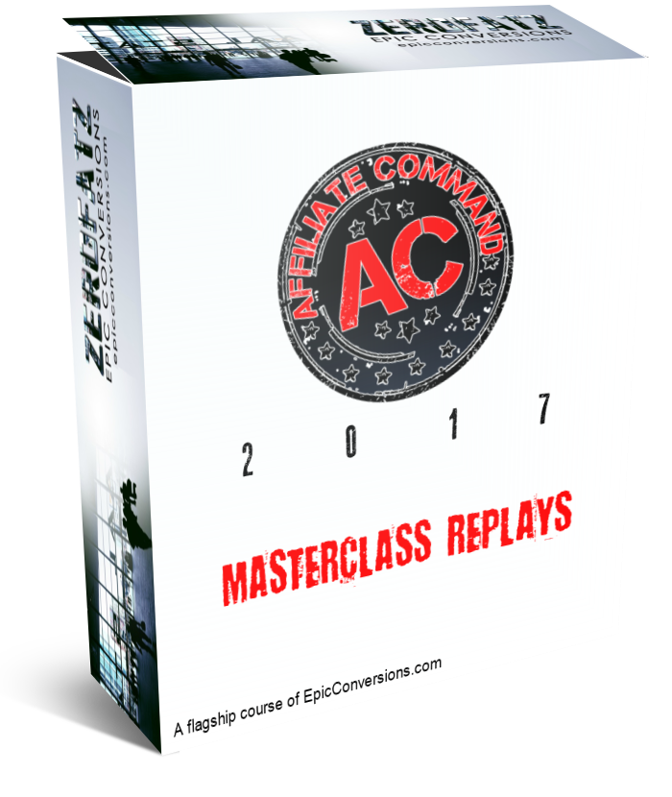
So pick this one up right now and be on your way to success faster than ever...

