Slide 1
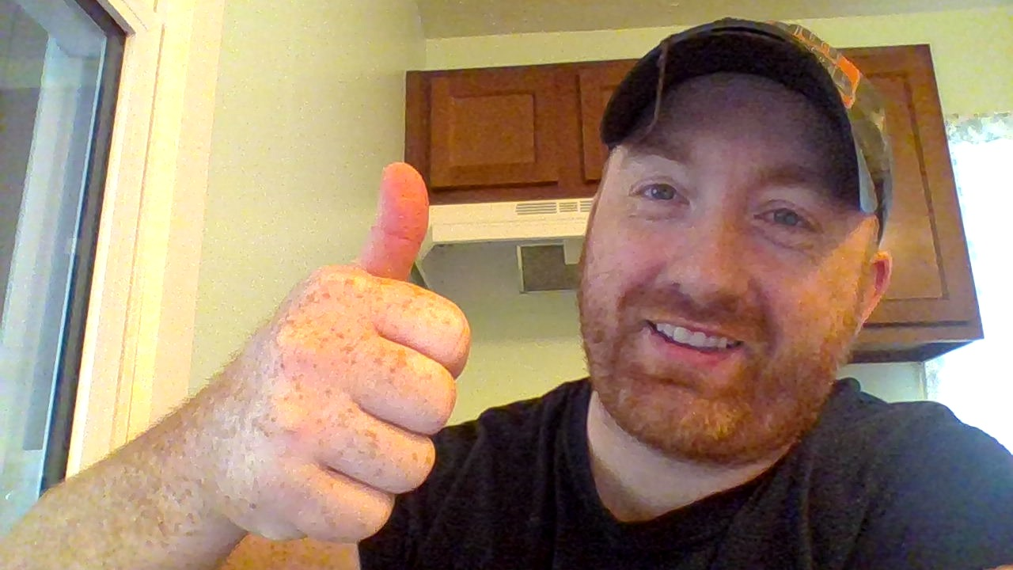
Hey! Kam Jennings here…

Slide 2
THANK YOU!!!
(and before I say anything else…)

Slide 3
I have a question for you...

Slide 4
Do you think that good email marketing is the key to sustainable success year in and year out online?

Slide 5
Because I could give you lots of statistics like...

Slide 6
How 86% of business professionals prefer to use email when communicating for business purposes...

Slide 7
Or that Consumers who purchase products through email spend 138% more than those that don’t receive email offers.

Slide 8
What about the fact that Email subscribers are 3x more likely to share content on social media than leads who came through another channel...

Slide 9
Or this little humdinger:
80% of retail professionals indicate that email marketing is their greatest driver of customer retention (the next closest channel? Social media, identified by just 44% of those same professionals).

Slide 10
I could even hit you with my personal favorite. In 2017 my business Epic Conversions generated over 80% of all revenue through email transactions...

Slide 11
I could go on and on convincing you...

Slide 12
But I mean, look, it’s 2018. If you don’t get it by now then this video probably isn’t for you.

Slide 13
So let me ask that question again and this time I’ll give you a few seconds to think about it...

Slide 14
Do you think that good email marketing is the key to sustainable success year in and year out online?

Slide 15
5

Slide 16
4

Slide 17
3

Slide 18
2

Slide 19
1

Slide 20
Alright...are they gone?

Slide 21
Good.
Now I’m speaking to the smart ones.

Slide 22
You get that me and everyone else online seeing major success is achieving it and sustaining it with valuable email lists.

Slide 23
We make it our business to build them...

Slide 24
...to keep the people on those lists interested in what we have to say...

Slide 25
...and to sell them things that will help them or add value to their lives.

Slide 26
That sounds pretty straight forward right?

Slide 27
So the next question you have to ask yourself then is why do so many people fail?

Slide 28
Because let’s be honest here...90% of all online businesses fail within the first 120 days.

Slide 29
Why?

Slide 30
Well, I can only speculate. However...

Slide 31
Here is what I know.

Slide 32
When most people figure out that they need to build an email list to see true success online...

Slide 33
They start looking for quick ways to do that.

Slide 34
This inevitably leads them into the open arms of solo ad vendors and facebook paid advertising.

Slide 35
These solutions are going to build them expensive email lists fast...

Slide 36
Here’s the problem...

Slide 37
Those lists are ice cold.

Slide 38
Those people probably won’t be opening a lot of your emails...

Slide 39
and they definitely won’t be buying a lot of your offers.

Slide 40
These people don’t know you, they don’t like you, and they don’t trust you.

Slide 41
So generally that leaves you with an expensive email list that is more of a liability than an asset.

Slide 42
It also leaves you feeling frustrated...

Slide 43
Maybe even feeling like you’ve been lied to by some guru selling you some big fancy pants course.

Slide 44
Are you tired of trying to build email lists that never get you anywhere?

Slide 45
Are you fed up with trying to send out emails that just get ignored?

Slide 46
Do you see other people putting out amazing content and making tons of money but can’t make it happen for yourself?

Slide 47
Stinks doesn’t it?

Slide 48
“I want to spend thousands of dollars trying to start an online business and make zero progress at all…”

Slide 49
Said nobody EVER!

Slide 50
Look...

Slide 51
Real online business works like this.

Slide 52
We build an audience.

Slide 53
2. The email list is the core of the audience.

Slide 54
3. Sell things to list and make money.

Slide 55
You can totally build the list before you build the audience.

Slide 56
But it doesn’t mean that you can skip building the audience.

Slide 57
No matter how you put people on your email list...

Slide 58
You will have to find a way to get them to know, like, and trust you to see success by email.

Slide 59
Don’t worry I am going to tell you exactly how to do it right here.

Slide 60
You want to use something called an indoctrination series.

Slide 61
It’s a special set of emails that are designed to take cold leads (people who don’t know, like or trust you)...

Slide 62
...and turn them into eager buyers who listen to everything you have to say.

Slide 63
It’s an extremely powerful tactic.

Slide 64
I knew a 7 figure marketer who’s main business was high ticket coaching and consulting...

Slide 65
...he would sell low ticket products...

Slide 66
Send those new buyers through a 30 day indoctrination series before he ever pitched any coaching or consulting...

Slide 67
The indoctrination series was designed to introduce the new people into his “world” so to speak.

Slide 68
That series of emails would be full of stories and actionable content...

Slide 69
It would have special measures set up to test engagement and click through rates...

Slide 70
And by the time those leads made it through his indoctrination series he had built massive rapport and authority with those leads.

Slide 71
So when it was time to offer 2k, 5k and even 25k coaching and consulting packages, people were chomping at the bit to work with him.

Slide 72
But the magic of the whole system to me was that simple indoctrination series that did the heavy lifting of building rapport, authority, and warming that ice cold list up.

Slide 73
Now that’s not an isolated occurrence or some rare discovery...

Slide 74
Most successful marketers have indoctrination or re-engagement series’ that they use to produce similar results.

Slide 75
Over the last few years I have used these same strategies to build massive authority and rapport with my audience.

Slide 76
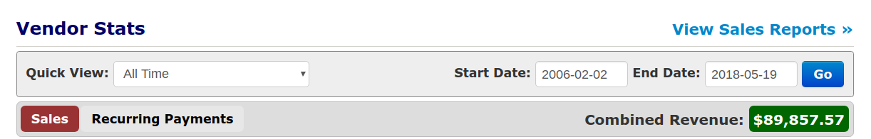
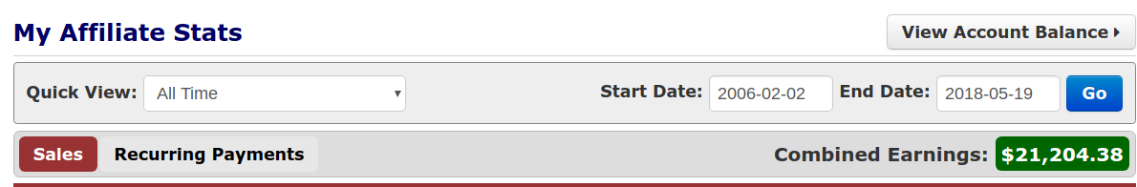
I have produced amazing results using tactics like the indoctrination series to warm up my lists...

Slide 77
The main problem though is this...

Slide 78
To make this work, you have to know how to write an indoctrination series of emails.

Slide 79
You have to have the time to dedicate to writing 4 weeks worth of them...

Slide 80
...and you have to take the time to fill them full of actionable content and stories to build rapport.

Slide 81
On top of that you need to add engagement and click through loops to test response and click through rates as your leads progress through the series...

Slide 82
Essentially, you are building a very special tool that is designed to do something very important.

Slide 83
But wait a second...

Slide 84
Wouldn’t it be cool if you had an experienced marketer to just do it for you?

Slide 85
Someone who already knew what it took to warm up people and build massive rapport and authority...

Slide 86
Someone who already had experience getting people to buy things and has made thousands upon thousands of dollars online with email...

Slide 87
Wouldn’t it be cool if you could get someone like that to just write an indoctrination series for you?

Slide 88
Well, you are in luck.

Slide 89
I have written such an email series for you...

Slide 90
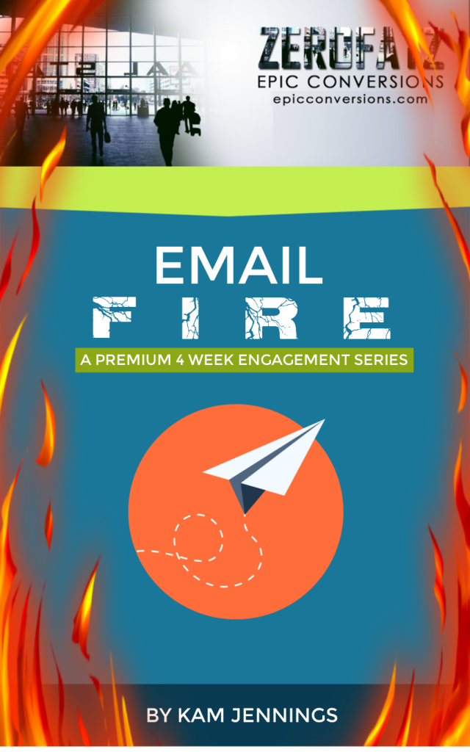
I proudly present...

Slide 91
Email Fire is a Premium 4 Week DFY Email Engagement Series

Slide 92
It has over 7,000 words and 4 weeks worth of emails...

Slide 93
Full of interesting and thought provoking stories to build rapport...

Slide 94
Packed with actionable content to build authority...

Slide 95
Laced with engagement loops so that you can test how interested your list is in what you have to say...

Slide 96
Lined with Click Through loops so that you can measure how ready your list is to buy from you...

Slide 97
A system like this will allow you to measure engagement, rapport with list, and adjust based on performance...

Slide 98
Email Fire IS a workhorse of an email sequence. It’s a dedicated tool built for a simple yet extremely important task...

Slide 99
Take cold leads or unresponsive email lists and get them responding and ready to buy from you.

Slide 100
Your not going to need to come up with crazy amounts of thoughtful stories to entertain people and build rapport (I got you covered!)

Slide 101
Your not going to need to come up with crazy amounts of thoughtful stories to entertain people and build rapport (I got you covered!)
You won’t need to write out loads of free actionable content (it’s all in there already!)

Slide 102
Your not going to need to come up with crazy amounts of thoughtful stories to entertain people and build rapport (I got you covered!)
You won’t need to write out loads of free actionable content (it’s all in there already!)
You’re not going to have to spend ages planning out a sequential email series that makes sense and builds massive authority for you (I did it for you!)

Slide 103
Your not going to need to come up with crazy amounts of thoughtful stories to entertain people and build rapport (I got you covered!)
You won’t need to write out loads of free actionable content (it’s all in there already!)
You’re not going to have to spend ages planning out a sequential email series that makes sense and builds massive authority for you (I did it for you!)
And on top of all that, you aren’t going to have to pay an arm and a leg for this PREMIUM indoctrination series either! (I’ve got it prices at a severe discount)

Slide 104
Listen...

Slide 105
Email Fire is a PREMIUM 4 week email engagement series for the digital marketing niche

Slide 106
Throughout those 4 weeks it tells stories and teaches in the areas of:
Week 1 - Email Marketing

Slide 107
Throughout those 4 weeks it tells stories and teaches in the areas of:
Week 1 - Email Marketing
Week 2 - Lead Acquisition

Slide 108
Throughout those 4 weeks it tells stories and teaches in the areas of:
Week 1 - Email Marketing
Week 2 - Lead Acquisition
Week 3 - Content

Slide 109
Throughout those 4 weeks it tells stories and teaches in the areas of:
Week 1 - Email Marketing
Week 2 - Lead Acquisition
Week 3 - Content
Week 4 - Acquiring and Launching Digital Assets

Slide 110
And now I want to make a bold statement because I know it to be true.

Slide 111
EVERYONE IN THE DIGITAL MARKETING SPACE COULD USE EMAIL FIRE!

Slide 112
I’m serious.

Slide 113
If you are in the digital marketing space, having Email Fire is like having a premium workhorse of a tool at your disposal.

Slide 114
And when it comes to email marketing and sustainable success online...

Slide 115
A thoughtfully crafted strategically written indoctrination series is exactly what you need.

Slide 116
Again…that’s where I come it.

Slide 117
Not only am I going to give you my PREMIUM 4 week Indoctrination email series...

Slide 118
I AM ALSO GOING TO GIVE YOU 3 ENTIRE SEASONS OF IM QUICK TIPS!

Slide 119
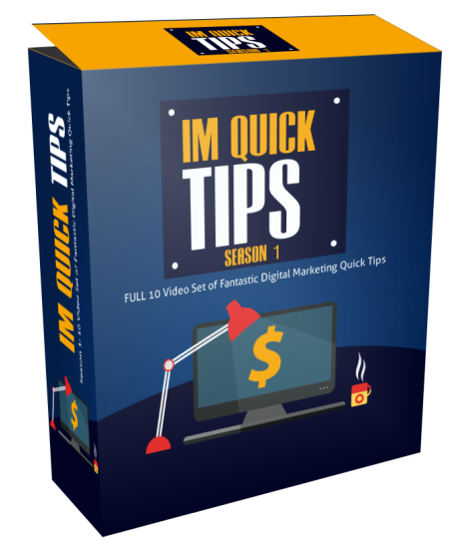

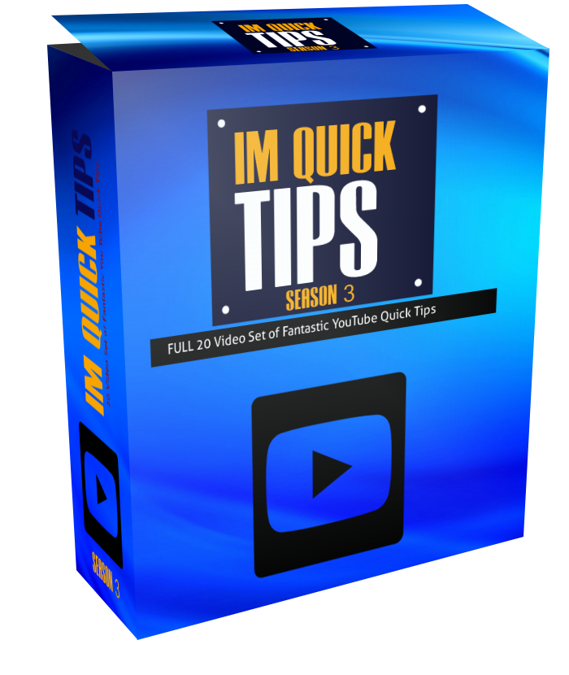

That’s over 40 videos of purely actionable content where I lay down specific strategies and tactics to help you win in the digital marketing space!

Slide 120
I don’t just want to give you a racecar here. I want to give you a racecar AND arm you with the knowledge on how to succeed with it!

Slide 121
Listen…
Email Fire IS an extremely powerful tool that employs strategies that have worked time and time again.

Slide 122
What’s new is that now you don’t have to spend years gaining the experience required to put together a series of this premium caliber...
...I did it for you.

Slide 123
It’s the kind of option I never had when I first got started.

Slide 124
It would be fair to charge $250 for this indoctrination series that I wrote personally.

Slide 125
I know I personally have paid $250 for just 5 emails written by someone who knows what they are doing.

Slide 126
I’m not trying to bleed you dry on this though. This is a premium tool and I want you to get it at a good price.

Slide 127
I want you to win. Let’s make it easy.

Slide 128
You’re not paying $250 for this.

Slide 129
Not $147…

Slide 130
Not even $97…
And yeah that puts me square in the territory of putting in more work than what I will get back from writing this thing for you.

Slide 131
I don’t care.

Slide 132
I’m listing this series at $10.80.

Slide 133
It’s a launch week special.

Slide 134
After that I’m setting the series at $27. Still an incredible deal, just not launch week incredible.

Slide 135
Now look, in a moment I’m going to give you a call to action…

Slide 136
I want you to invest in your business here.
What I offer you is no trick. This is no mere gimmick.

Slide 137
This is exactly what you need to convert cold leads to warm traffic that wants to buy things from you.

Slide 138
AND I am going to give you 40 videos of IM Quick Tips content showing you tons of strategy and tactics in the digital marketing space!

Slide 139
Building a rock solid business on the internet when you are living directly in the middle of the information age is a no brainer.

Slide 140
I am going to leave Email Fire at $27 and if you look at it over the course of one year…

Slide 141
THAT’S LESS THAN .08 CENTS A DAY!!!

Slide 142
Would you be willing to invest .08 cents a day
over the course of one year for one of the greatest tools to ever grace the Internet Marketing space?

Slide 143
I would. And have.

Slide 144
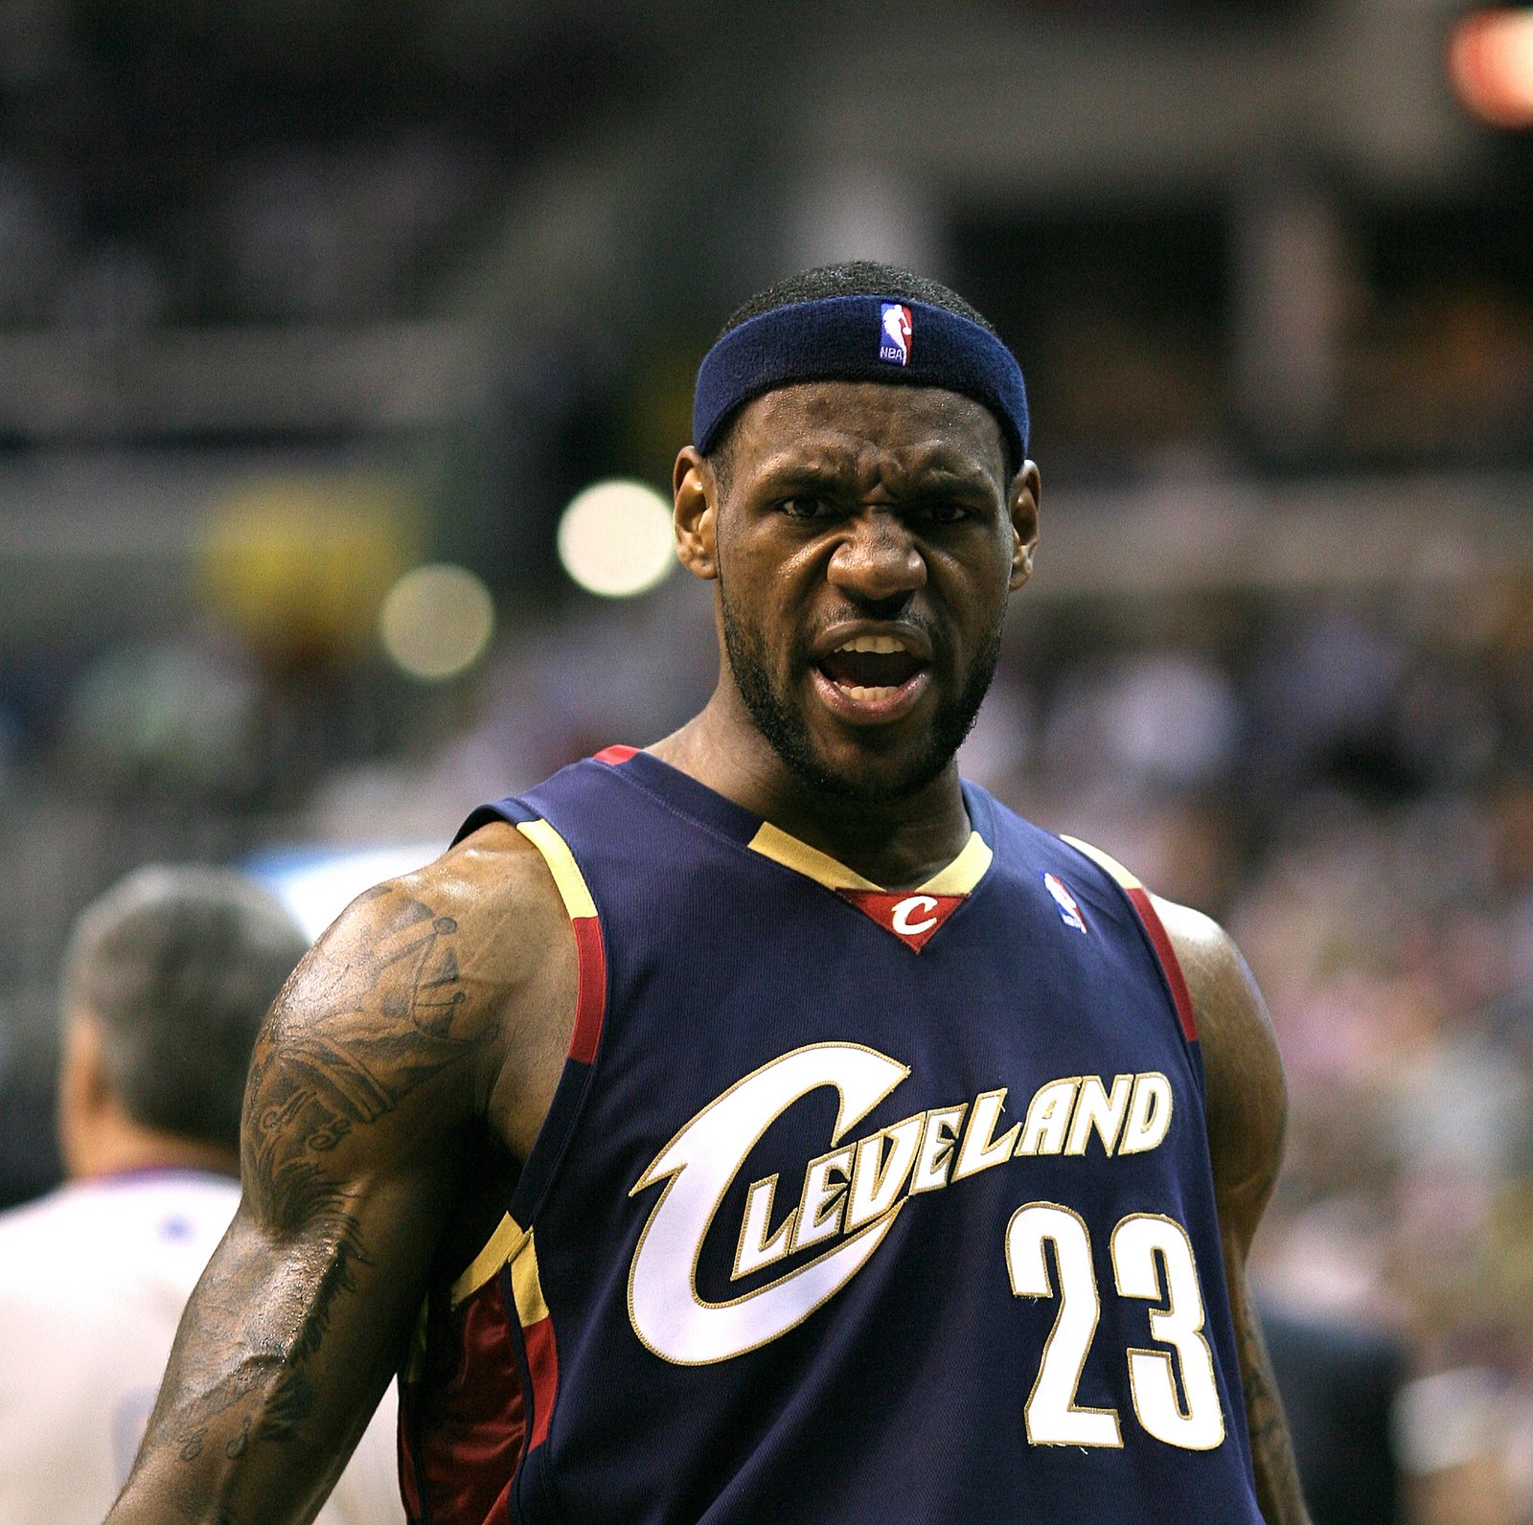
I'm going to use all my tools, my God-given ability, and make the best life I can with it.
LeBron James

Slide 145
With Email Fire you have all of my ability and experience infused into a tool for you to achieve sustainable success online.

Slide 146
The right tool for the right job. That’s how we win.

Slide 147
Today inside Email Fire you’re going to be instantly getting a tool that contains:
A 4 week (20 email) premium engagement sequence

Slide 148
Today inside Email Fire you’re going to be instantly getting a tool that contains:
A 4 week (20 email) premium engagement sequence
Pure value delivered with actionable content thought the entire sequence to build massive authority.

Slide 149
Today inside Email Fire you’re going to be instantly getting a tool that contains:
A 4 week (20 email) premium engagement sequence
Pure value delivered with actionable content thought the entire sequence to build massive authority.
Engaging entertainment delivered throughout the series in the form of story to build incredible rapport.

Slide 150
Today inside Email Fire you’re going to be instantly getting a tool that contains:
A 4 week (20 email) premium engagement sequence
Pure value delivered with actionable content thought the entire sequence to build massive authority.
Engaging entertainment delivered throughout the series in the form of story to build incredible rapport.
Insightful loops build into the sequence to test click through rates and engagement

Slide 151
Today inside Email Fire you’re going to be instantly getting a tool that contains:
A 4 week (20 email) premium engagement sequence
Pure value delivered with actionable content thought the entire sequence to build massive authority.
Engaging entertainment delivered throughout the series in the form of story to build incredible rapport.
Insightful loops build into the sequence to test click through rates and engagement
The invaluable insights and strategies scattered throughout the emails themselves which are full of experience and knowledge

Slide 152
Today inside Email Fire you’re going to be instantly getting a tool that contains:
A 4 week (20 email) premium engagement sequence
Pure value delivered with actionable content thought the entire sequence to build massive authority.
Engaging entertainment delivered throughout the series in the form of story to build incredible rapport.
Insightful loops build into the sequence to test click through rates and engagement
The invaluable insights and strategies scattered throughout the emails themselves which are full of experience and knowledge
A workhorse indoctrination sequence that can be used over and over to convert cold leads into warm buyers

Slide 153
IM Quick Tips Seasons 1 through 3! That’s over 40 videos of purely actionable content where I lay down specific strategies and tactics to help you win in the digital marketing space!
In addition to that you're also going to get instant access to:

Slide 154
I want you to click the button below and pick up
Email Fire

Slide 155
I’ll give you a few seconds to think about that...

Slide 156
5

Slide 157
4

Slide 158
3

Slide 159
2

Slide 160
1

Slide 161
Still not sure?

Slide 162
Consider this…

Slide 163
Let’s assume you’re going to buy this premium tool at its highest price point of $27

Slide 164
If you used everything I am giving you today to convert just 100 cold leads into warm buyers…

Slide 165
If you made those 100 people a $10 offer at the end of 30 days...

Slide 166
You would need only 3 of them to buy to make your initial investment in this tool back.

Slide 167
But I know from experience that I enjoy conversion rates of 18% to 20% using emails just like the ones that I packed into Email Fire.

Slide 168
If every month after that initial month you got 3 people to buy something for $10, by the end of the year you will have earned:
$360 - $27 = $333

Slide 169
The fact is if you had enough ambition and attention to make it to the end of this video… then you can sell AT LEAST 3 $10 products.

Slide 170
The truth is you can probably sell a lot more than that on a monthly basis.

Slide 171
Making money online doesn’t always have to be hard.

Slide 172
This is not the lottery. Hoping won’t do you any good here.

Slide 173
It’s about having the right strategies and tools in the right places.

Slide 174
I'm going to use all my tools, my God-given ability, and make the best life I can with it.
Don’t you think it’s about time to start putting some excellent tools to work for you?

Slide 175
Don’t you think it’s about time for YOU to start making the BOSS decisions?

Slide 176
You can do this. Time to step up and be the boss.

Slide 177
#BossLevelThinking

Slide 178
Email Fire is waiting to work for you…

