Slide 1
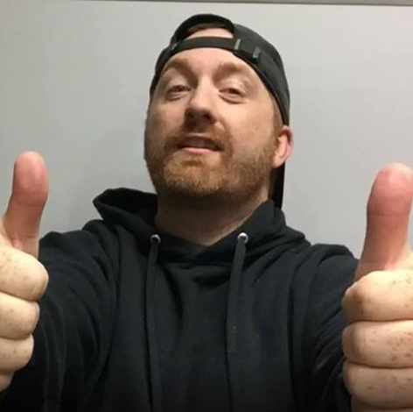
Hey, Kam here...

Slide 2
And this is going to be different than any video you’ve ever watched.

Slide 3
Yeah it’s going to be really fresh.

Slide 4

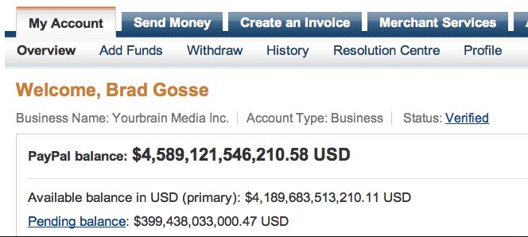
Because I’m not going to spend the whole video bragging about income...

Slide 5

Talking about how AWESOME my life is under a thinly veiled guise of helping you...

Slide 6
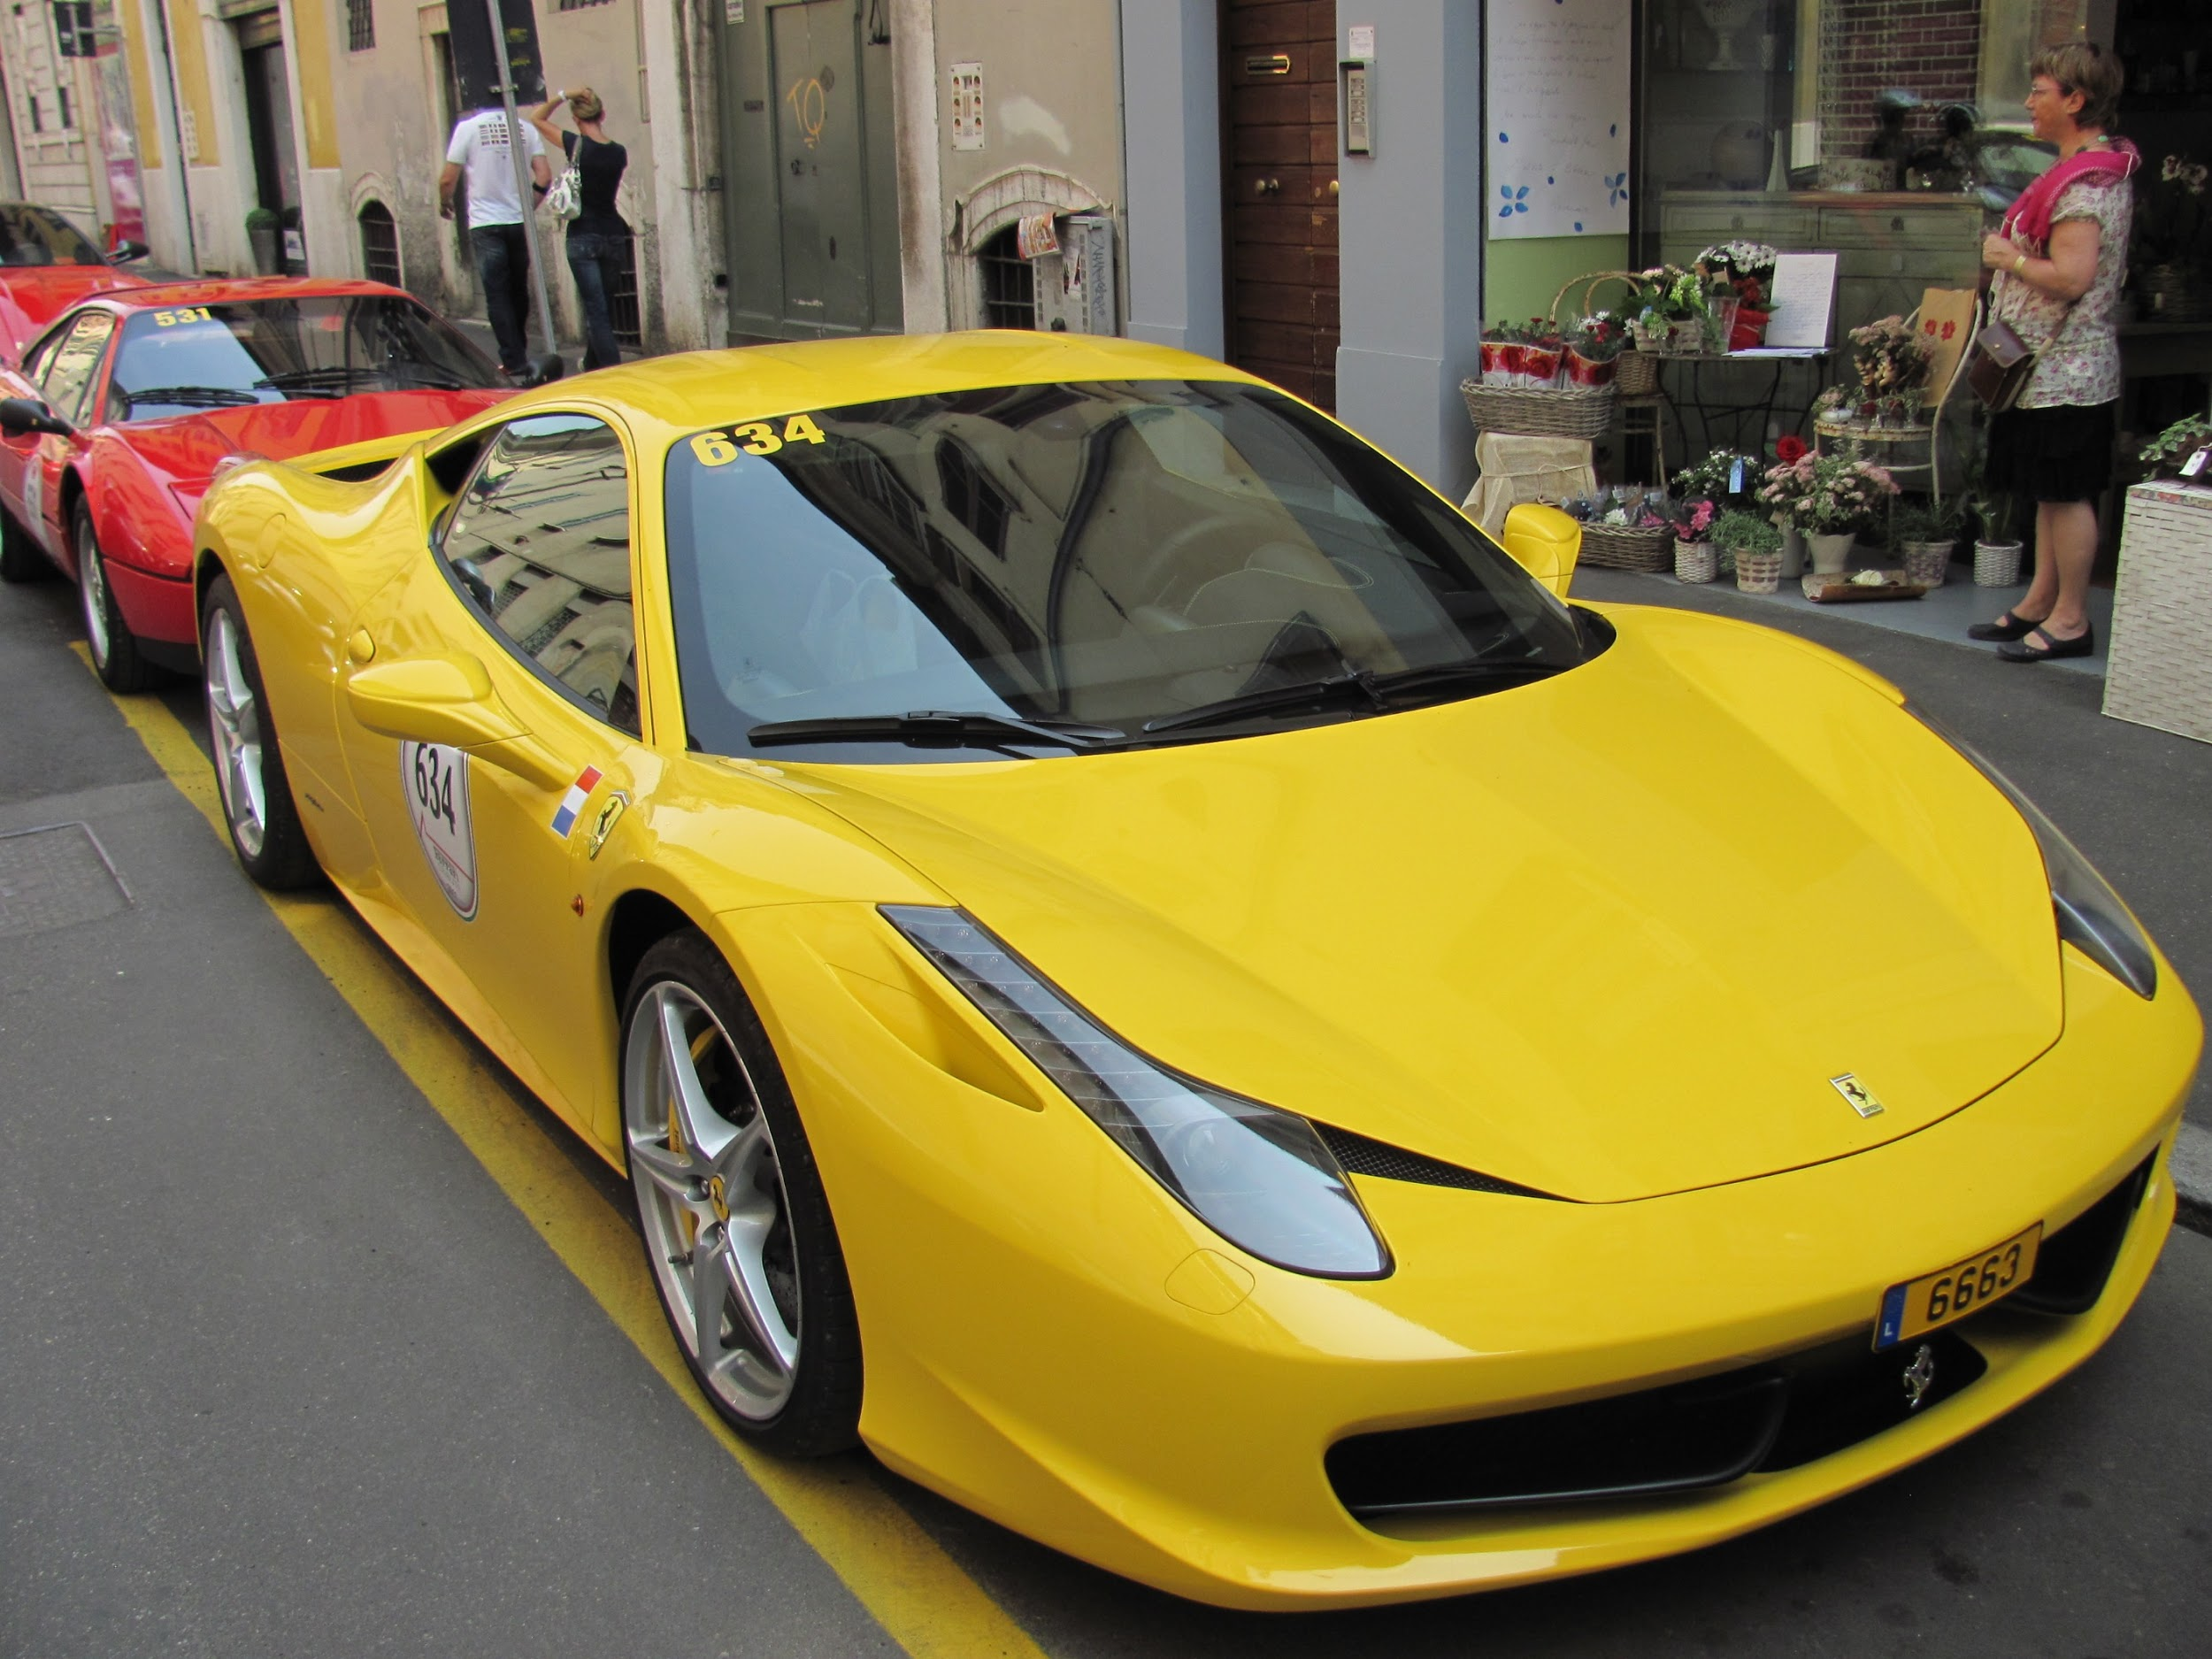
There’s not going to be any rented Super Cars

Slide 7

No crazy high production drone shots of paradise...

Slide 8
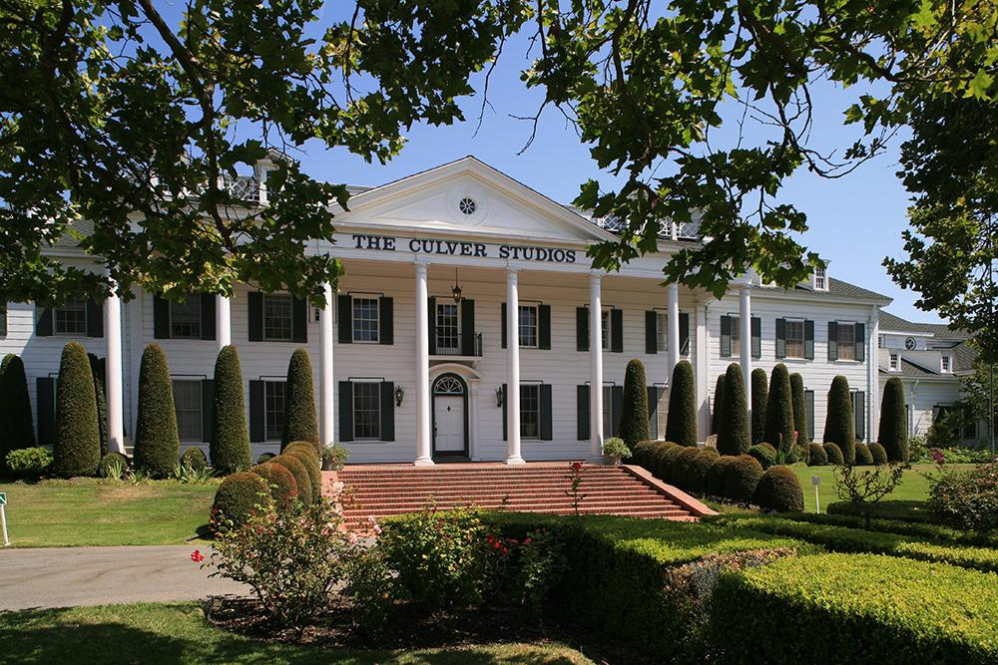
No fancy pants mansions in the Hollywood Hills...

Slide 9
Actually to be honest if I had a super car I might show it off a little bit...

Slide 10
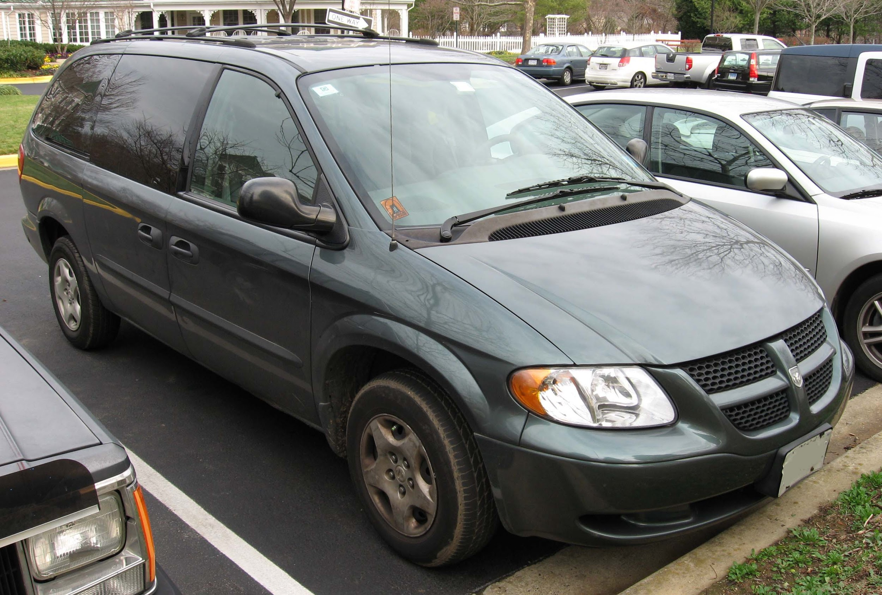
But alas I do not. I drive a used Dodge Caravan

Slide 11
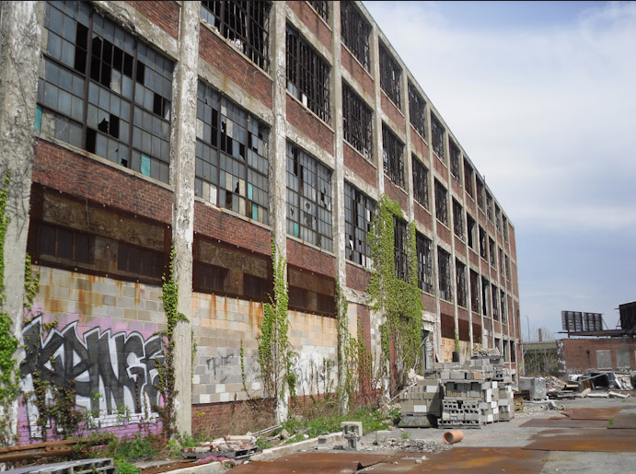
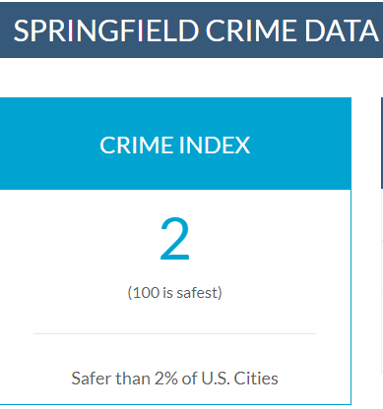
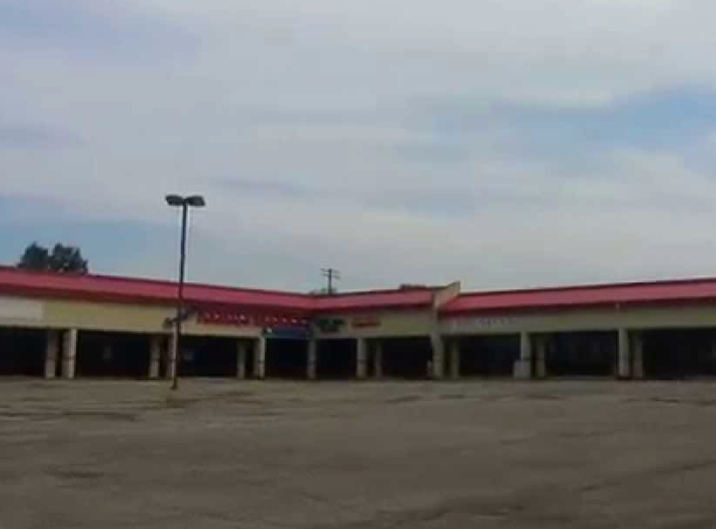

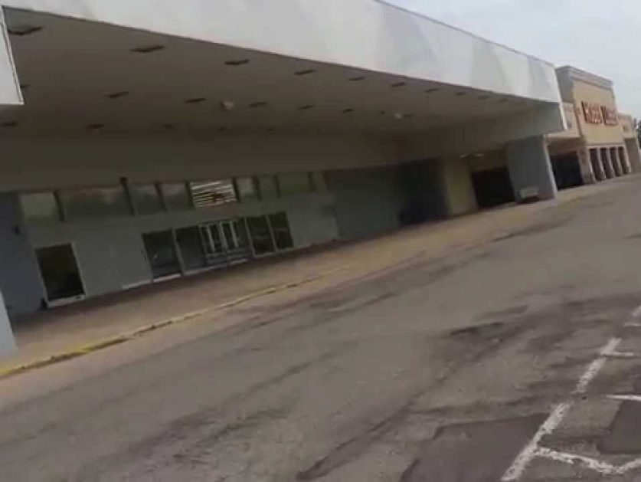
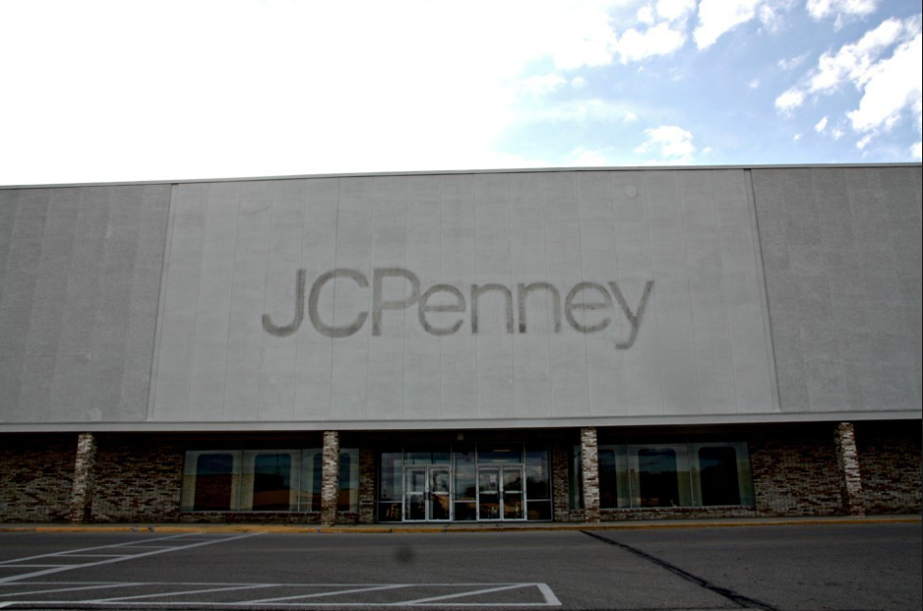
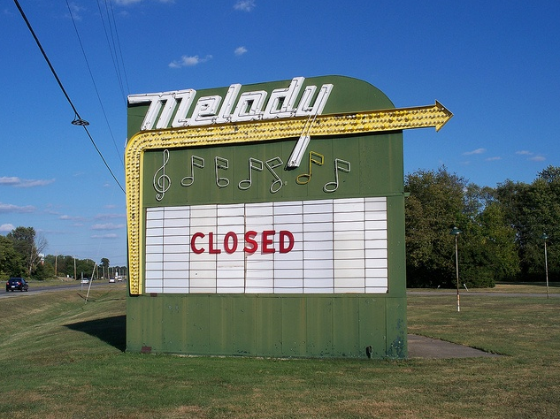
I own a normal house in a less than desirable neighborhood...

Slide 12
I have questionable hygiene and wear thrift store clothes...

Slide 13
Not exactly what you would expect from a big fancy internet guru right?

Slide 14
Well I learned a long time ago my life is infinitely better just being honest with people.

Slide 15
So that’s what I do.

Slide 16
Anyways...

Slide 17
Right about now you might be wondering...

Slide 18
Why the hell am I listening to this white trash douche bag?

Slide 19
What could this dumb hick from the ghetto possibly teach me?

Slide 20
Well there is something about me that is probably a little different than most of you.

Slide 21

I work for myself.

Slide 22
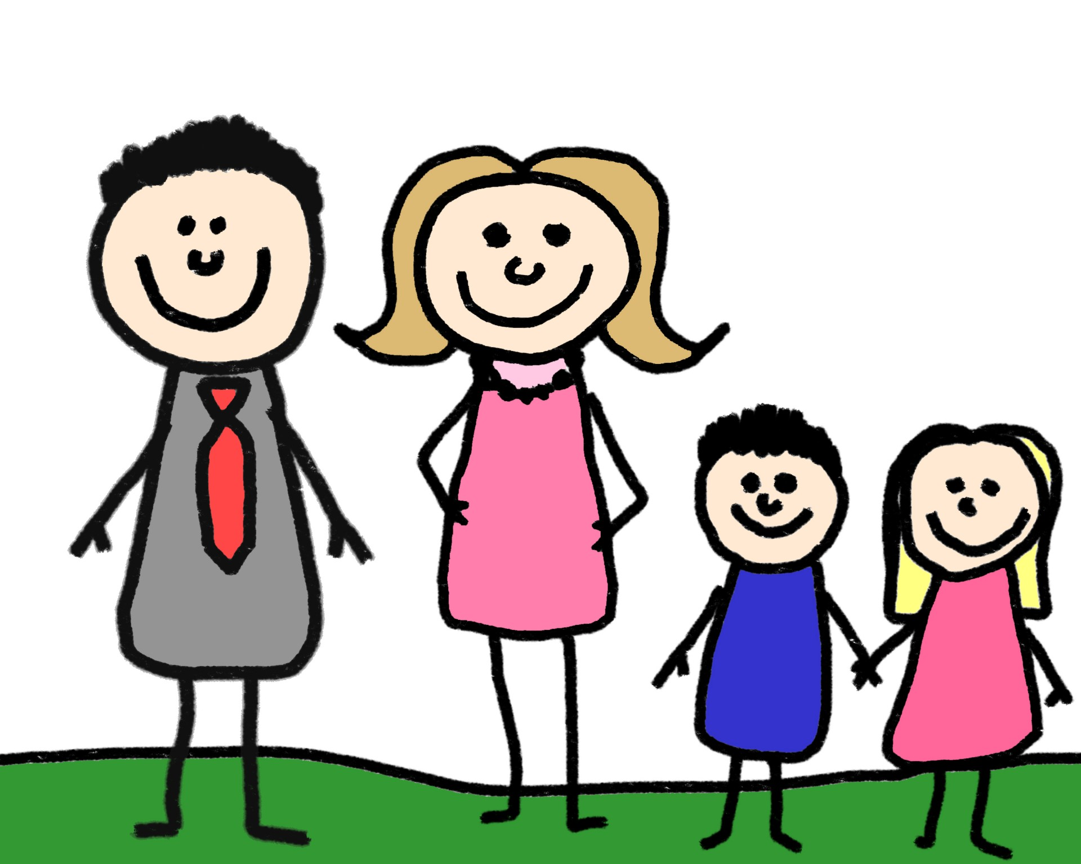
I support a family of 4 working for myself. And my wife doesn’t have to work.

Slide 23
And I know I said I own a house in a less than desirable neighborhood...

Slide 24
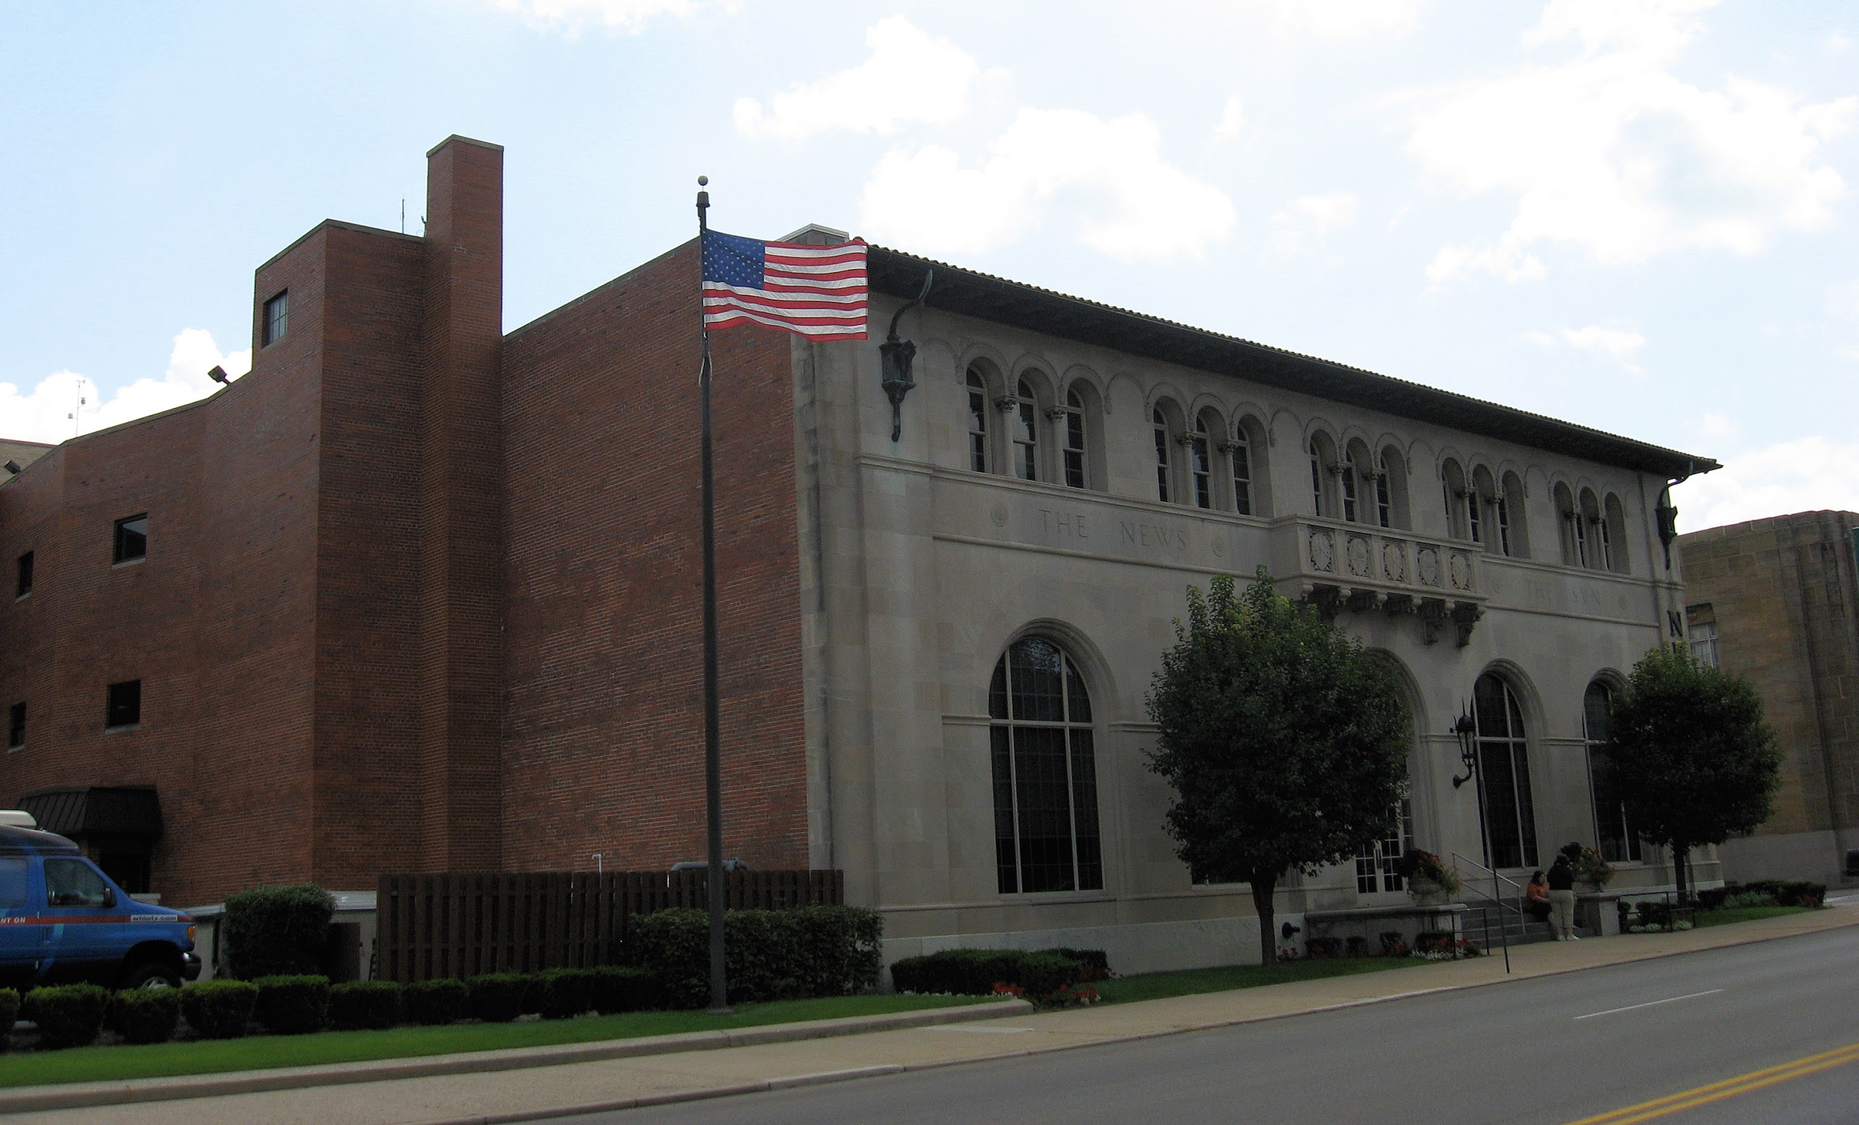

But I also rent an office downtown in said neighborhood...
I’m on the 3rd floor ;)

Slide 25
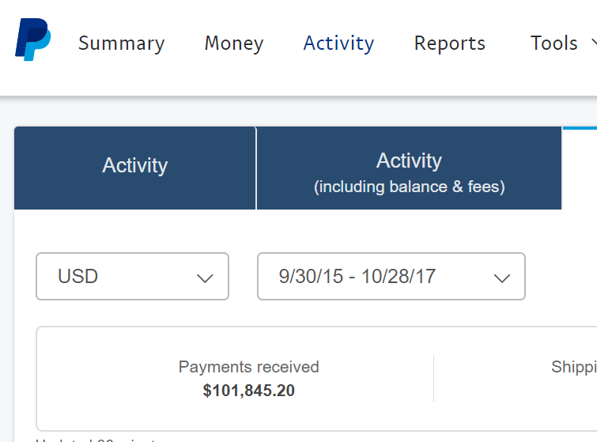
Oh...and I have made over 100k dollars on the internet in the last couple of years.

Slide 26
I’m not bragging about it. But I want you to know I’m not wasting your time.

Slide 27
Although I am a normal guy, I make my living working online for myself.

Slide 28
And that might make me a little different from you. No matter what I look like...

Slide 29
If you are out there right now and you’d like me tell you exactly what I do to make money online you are in luck.

Slide 30
I’m going to show you right here in this video.

Slide 31
But before I do let’s get one thing straight.

Slide 32
99% of the courses that you have bought out there are crap.

Slide 33
They are taught by newbies who haven’t done it or gurus who don’t care if you succeed.

Slide 34
You’ve been overcharged and under delivered on.

Slide 35
You might not be willing to admit it but stop and think for second...

Slide 36
What have they done for you?

Slide 37
NOTHING!

Slide 38
Most times you can’t even get a reply to a simple customer support email!

Slide 39
And honestly, until you are willing to admit that, you’ll never be able to move on to a real business model that actually works.

Slide 40
To succeed online you need 3 things...
A bunch of people who care about what you have to say on a specific topic
A product or a service
A way to sell it to those people

Slide 41
Anything more than that and it starts to get a little complicated and extremely easy to mess up...

Slide 42
I wish I could say I didn’t speak from experience on that one but I do.

Slide 43
That simple 3 step system is all you need to generate a full time living online

Slide 44
See, I have been launching products and running simple membership sites for several years now and made A LOT of money doing it.

Slide 45
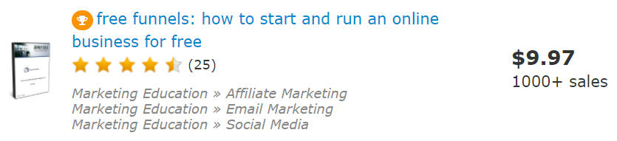
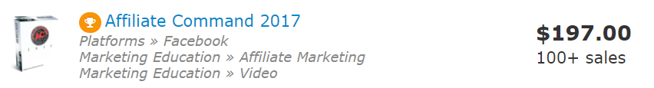
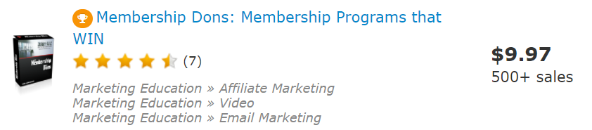
Some of my products have even earned awards for being so good...

Slide 46
All of it was based off this simple 3 step system...
Find a bunch of people who care about what you have to say on a specific topic
Create a product or a service
Sell it to those people

Slide 47
Now I’ve gotten pretty good at this little system if I do say so myself.

Slide 48
But a few months ago something shook me to the core.

Slide 49
It caused me to stop launching products and take a step back to re-evaluate what I was doing.

Slide 50

See, I was just coming off my most successful product launch to date...

Slide 51
...and I thought I had really perfected every single aspect of my craft.

Slide 52
So I decided to do a case study product about launching products.

Slide 53
I called it Launch Levels: Vol 1 and I felt like coming 4 weeks after my most successful launch ever...this can’t lose.

Slide 54
I was going to actually show people the whole process of what I do so they can repeat it exactly!!!

Slide 55
I sold over a thousand copies of Free Funnels. This was going to sell 2 thousand copies!

Slide 56
I had the perfect formula. It was locked down!
Right?

Slide 57
wrong.

Slide 58

Launch Levels: Vol 1 sold 186 units.

Slide 59
I was devastated.

Slide 60
Not because the product failed but because I didn’t understand why it failed.

Slide 61
The whole thing was confusing to me. I hated not understanding. It felt too unpredictable.

Slide 62
Sustainable online businesses aren’t based on things that are unpredictable.

Slide 63
To be honest it kind of scared me.

Slide 64
I had to do some real soul searching, ask my closest peers for honest feedback and take a couple months off...

Slide 65
And you know what I figured out?

Slide 66
The perception and the truth is this...

Slide 67
Launch digital products successfully is hard. As a result, people see it as hard.

Slide 68
I didn’t make it look easy on my sales page. And people were not interested in something that was too hard for them to do.

Slide 69
Now I know that simple 3 step process I told you about works amazingly well.

Slide 70
I have used it over and over again to create wealth.

Slide 71
But what I didn’t realize was that the further away I got from being a newbie...

Slide 72
The harder it was for me to relate to what it was like to be a newbie...

Slide 73
So I threw out my entire process.

Slide 74
And I started over.

Slide 75
This time I asked the newbies questions.

Slide 76
Instead of talking. I listened.

Slide 77
And you told me everything that was wrong with creating and selling digital products...

Slide 78
How it was too hard to come up with original and unique product ideas...

Slide 79
How it was incredibly difficult to stay focused on the project...

Slide 80
How it was hard to figure out if people would even like or buy what you spent so much time on...

Slide 81
How Perfectionism was stalling you out and keeping you from moving forward...

Slide 82
How the technical aspect of everything was holding you back...

Slide 83
How not having an email list makes you feel like it’s impossible to even do it...

Slide 84
Or even why the simple aspect of just plain not knowing how or where to start...

Slide 85
Completely paralyzes you and leaves you stranded in “NO MONEY LAND”

Slide 86
I needed to solve all those problems for you.

Slide 87
It’s not good enough to show you what I did with a case study if it’s too damn hard for you to do...

Slide 88
I needed to created the Layman’s guide to making money on the internet.

Slide 89
no.

Slide 90
I needed to create The White Trash Guide to Producing Wealth on the Internet

Slide 91
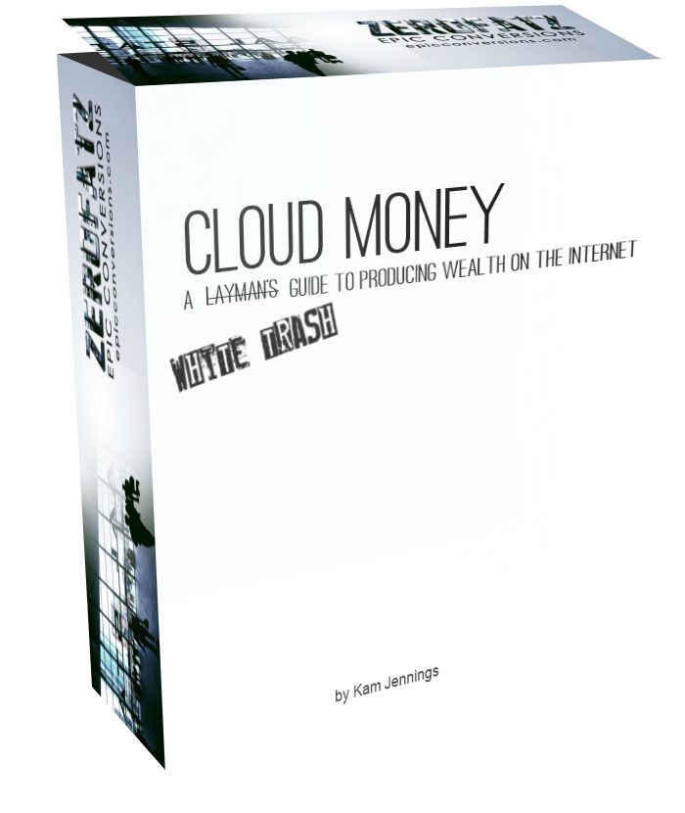
So I did...

Slide 92
It wasn’t pretty.

Slide 93
It wasn’t fancy.

Slide 94
It wasn’t hypey.

Slide 95
It was a simple, straight forward system that worked.

Slide 96
It takes you by the hand and walks you through 8 simple steps to producing profitable digital assets.

Slide 97
How to get started the right way is in there...

Slide 98
How to make sure you are creating something people want to buy is in there...

Slide 99
How to create it fast and make it awesome is in there...

Slide 100
How to deliver the product in a special way that’s going to produce highly engaged return customers is in there...

Slide 101
How to create simple yet devastatingly effective sales funnels is in there...

Slide 102
How to create super easy sales copy quickly that crushes it is in there...

Slide 103
And the technical stuff?

Slide 104
I got you covered. You get to watch me DOING ALL OF IT!

Slide 105
IT’S IN THERE!

Slide 106
And not only that...

Slide 107
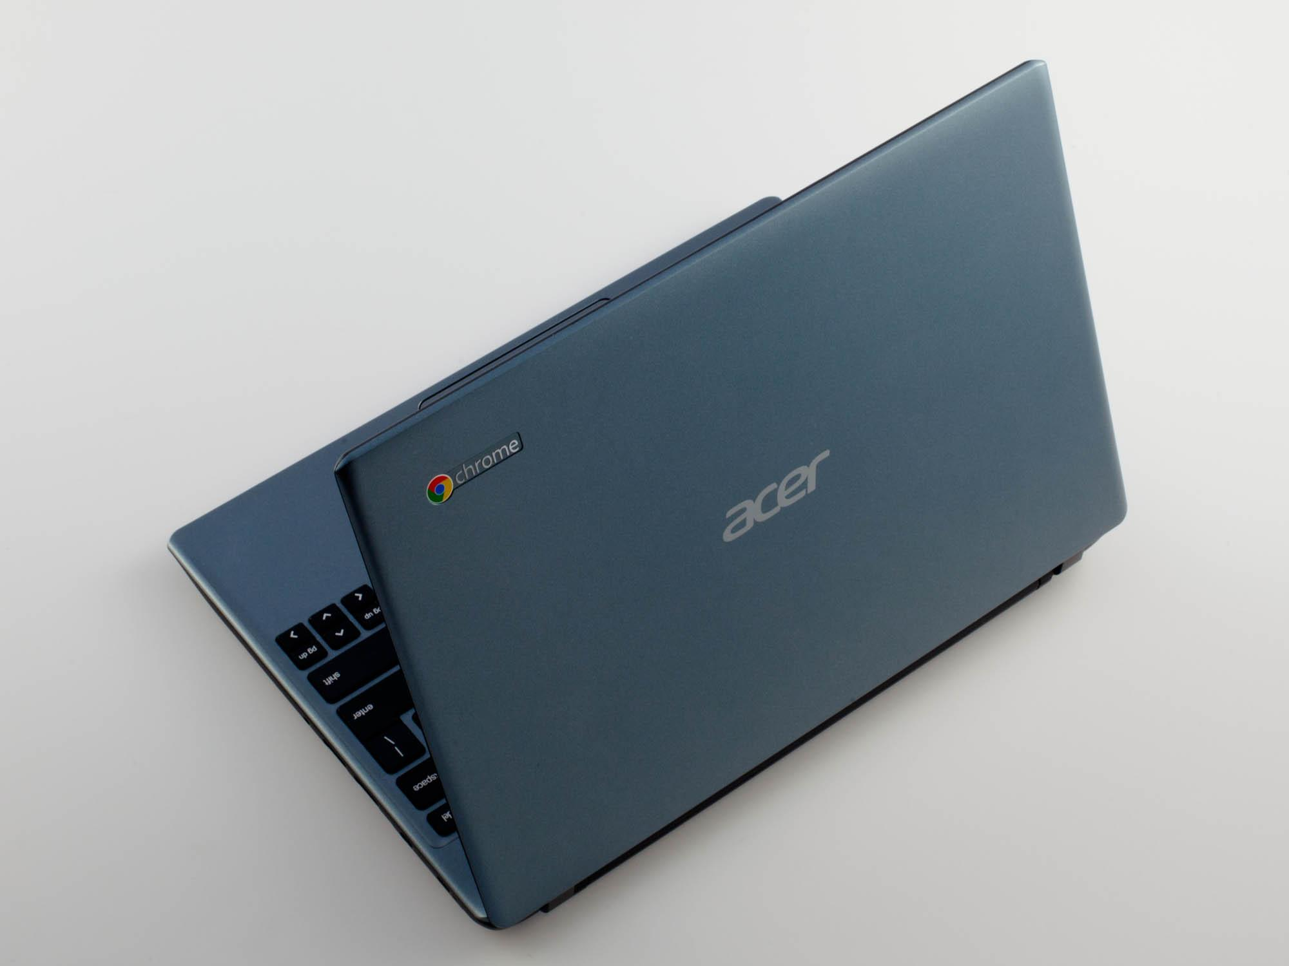
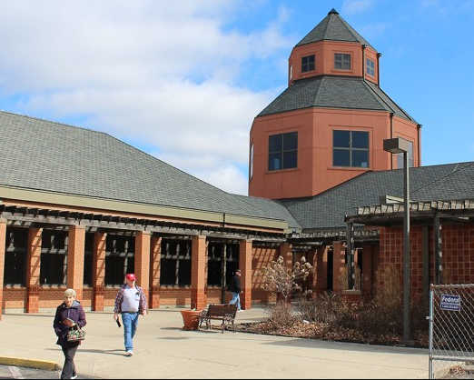
In Cloud Money, I do it from my downtown library with a cheap Chromebook that has no hard drive.

Slide 108
Seriously, most of you probably have a much better situation than that.

Slide 109
I did it because I wanted to show you what was possible.

Slide 110
You don’t need a fancy office or expensive equipment to make your online dream happen.

Slide 111
You just need a little determination and a solid proven path.

Slide 112
Cloud Money: A White Trash Guide to Producing Wealth on the Internet
is that path...

Slide 113
We are talking about a course that was created from the ground up with a complete newbie in mind.

Slide 114
It is assumed that you have no technical knowledge...

Slide 115
no list...

Slide 116
No audience...

Slide 117
No experience...

Slide 118
No knowledge of product creation...

Slide 119
No nothing.

Slide 120
We are going to start from Chapter 1.

Slide 121
We are going to go to Chapter 8.

Slide 122
And when we are done you are going to have a digital asset that can make you money.

Slide 123
More importantly, you’ll have it set up to receive money...

Slide 124
You’ll know exactly where and how to get people to buy it...

Slide 125
And I will have walked you through how to set the whole thing up so you can do it over and over again.

Slide 126
In fact, I want to make a couple of promises to you right now before you get inside Cloud Money.

Slide 127
PROMISE 1
I’m not going to get all technical with you. Anything that even smells like technical and I am just going to show you what to do.

Slide 128
PROMISE 2
I’m not going to force you to buy anything else to make this work. Everything you need is right here inside Cloud Money.

Slide 129
PROMISE 3
I am going to SHOW you everything you need to start earning money on the internet inside this course.

Slide 130
So now I have a pretty serious question for you...

Slide 131
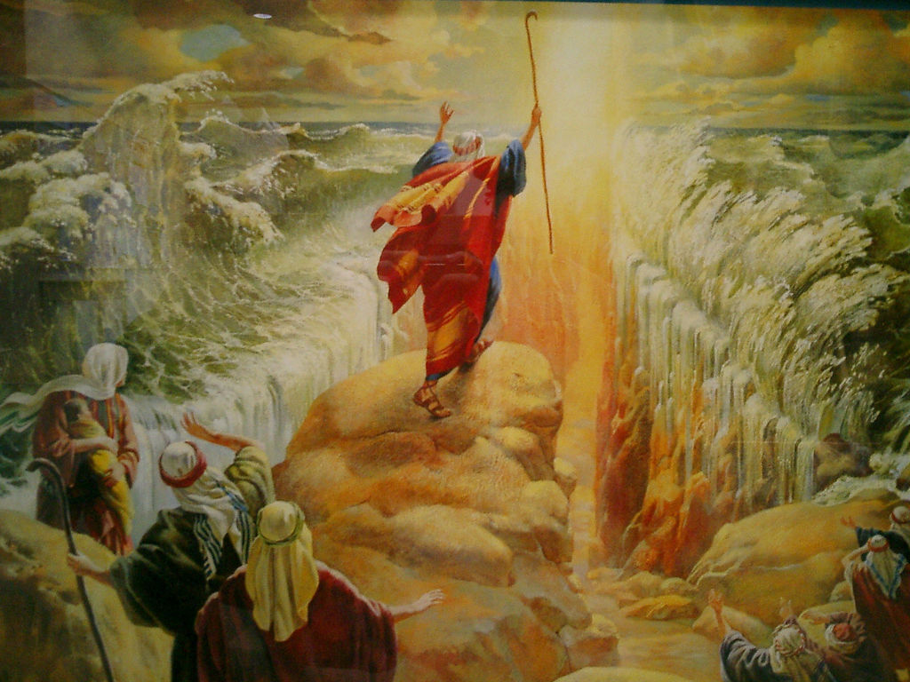
Are you ready to cut a path through the sleaziness of the IM Game?

Slide 132
The fake cars, houses, models, lives and constant bragging?

Slide 133
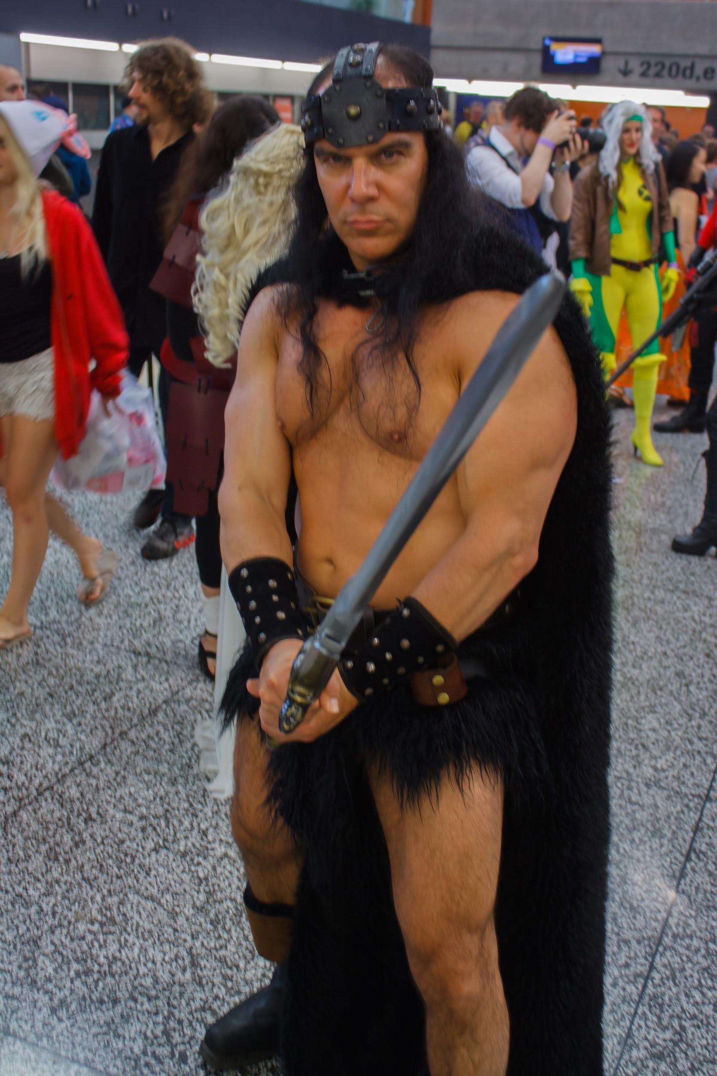
I’m being serious here because all that stuff is about 95% fantasy.

Slide 134
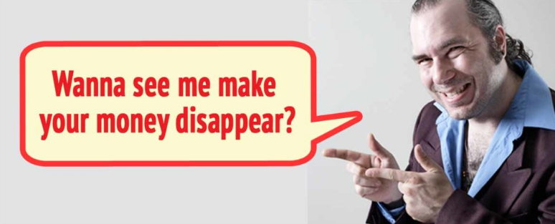
The truth is most of that stuff is either fantasy for the people selling it too or it took them a long time to achieve...

Slide 135
So how could you ever expect it to be something that would be true for you or me?

Slide 136
If you're finally ready to step away from the BS and build a real business that you can actually be proud of then you are in the right place my friend.

Slide 137
You are going to get everything you need to succeed right here in Coud Money...and if you take action on this thing...

Slide 138
You’ll never have to worry about buying another overpriced ‘let me show you inside my paypal account’ product again!

Slide 139
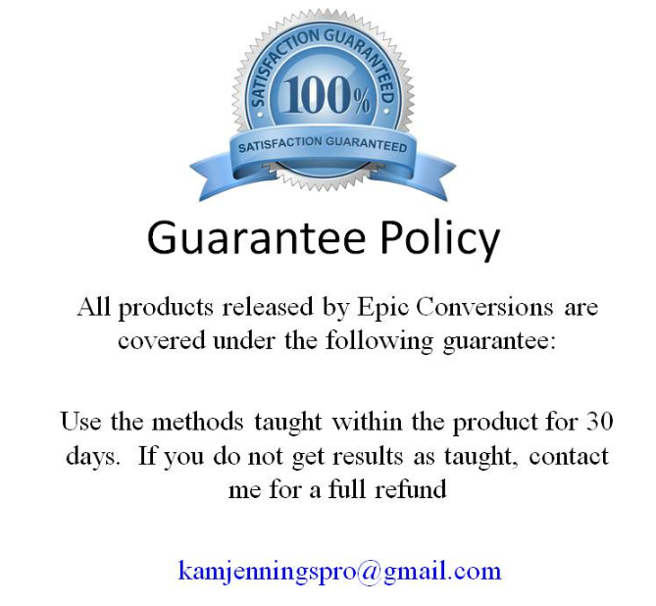
I also offer a very special guarantee on everything I do.

Slide 140
Not because I have to. MY products are awesome and they work so I don’t need to worry about that.

Slide 141
I do it because I know one of the main problems people face out there is execution.

Slide 142
I want you to win. For you to win, you need to take action. The guarantee policy helps.

Slide 143
On top of that, all of my payments are processed through paypal so you are 100% protected by them as well.

Slide 144

SO now we stand at a crossroads and you have 2 choices...

Slide 145
You can continue your search and keep getting taken advantage of by theory pushers and “gurus” all day...

Slide 146
Or you can join forces with someone who really does it and has been honest with you every step of the way.

Slide 147
Someone with a process to get you from where you are now to where you want to be.

Slide 148
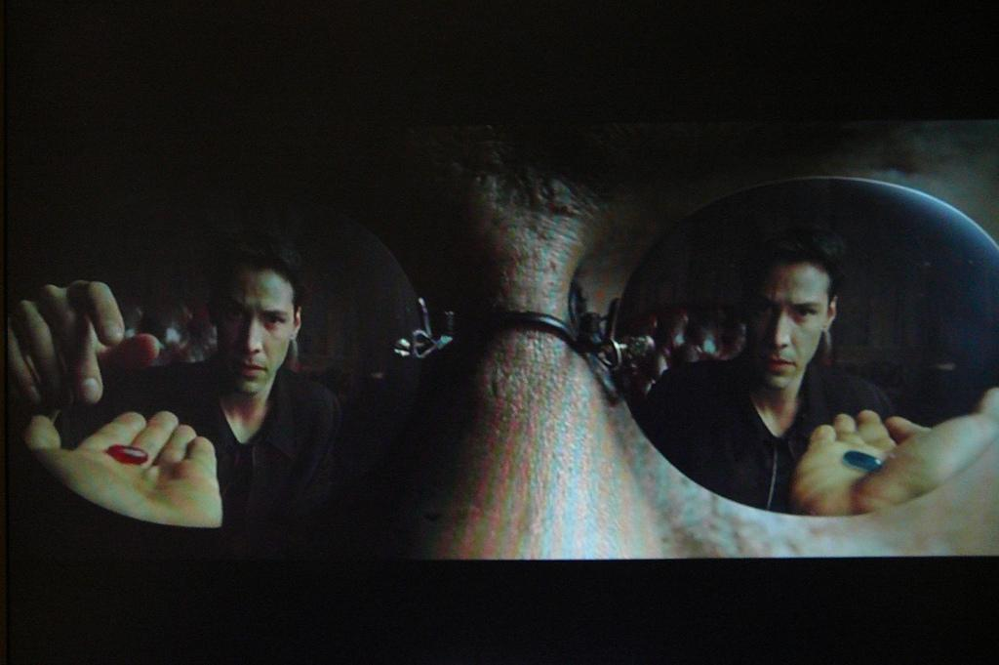
The choice is yours...

Slide 149
My advice is, if you are already doing something right now, see that through to the end. When you figure out it’s worthless and you don’t see any results come on back.

Slide 150

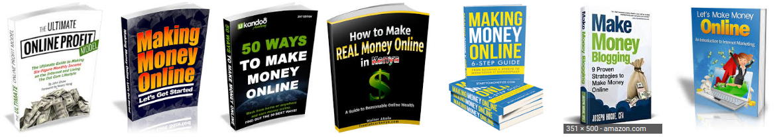
And if you’re not quite through believing in the fantasy...buy a few more...then come back.

Slide 151
But if you're finally ready to take things to the next level and partner with a real businessman who does this everyday for a living...

Slide 152
And start building a legitimate business that actually makes you money...

Slide 153
Then click the Buy Button below and let’s get started.

Slide 154
And if you buy within my launch week promotion you are going to get this for less than 10 bucks!

Slide 155
Over the course of a year that’s less than .03 cents a day!!!

Slide 156
Would you be willing to pay .03 cents a day to potentially change your life forever?

Slide 157
I would and have.

Slide 158
The point here is that you can spend a very small amount of money with no risk on your part to see if this business model is right for you.

Slide 159
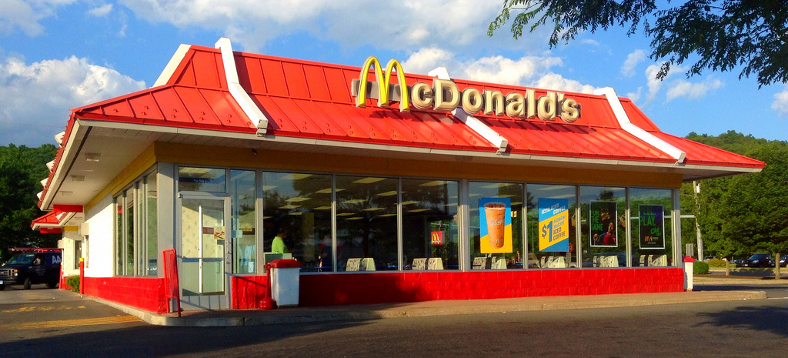

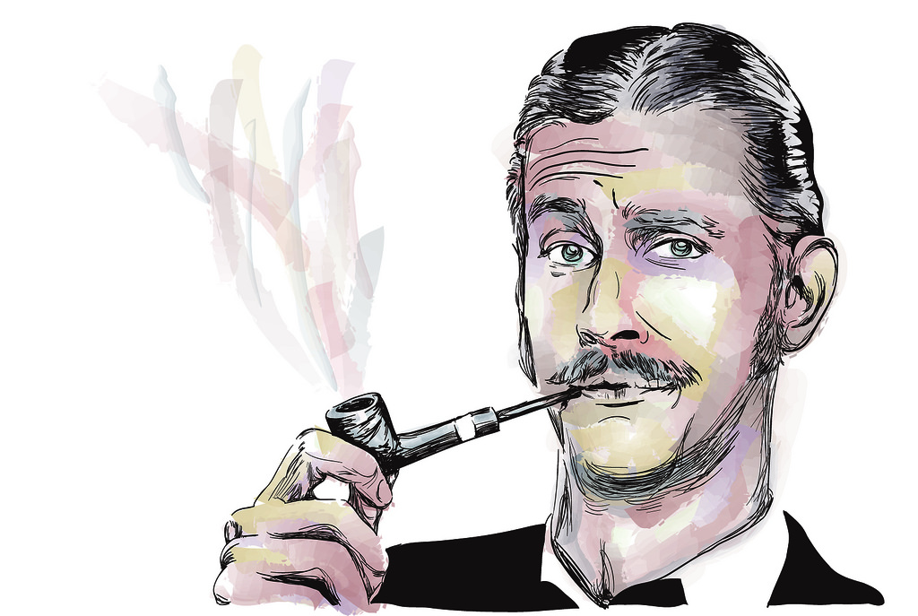
Or you can save your 10 bucks for a rainy day and a meaningful trip to McDonalds...
CLASSY!

Slide 160
Now let’s say everything I said here was wrong, and the entire model I have created fails EPICALLY with you making nothing at all...

Slide 161
Couldn’t you still get your money back in 30 days along with a case study of your experience?

Slide 162
A case study that you could put on a blog to get you traffic or on a youtube channel to earn you money with a monetized video?

Slide 163
Of course you could. How do I know?

Slide 164

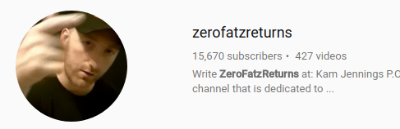


Because I have a blog...and a youtube channel...

Slide 165
You could do that but you’re not going to have to.

Slide 166
Honestly, wouldn’t the small amount of money you pay for this course be worth it just to figure out how to create highly engaged products quickly?

Slide 167
Or how to find just the right people to sell them to?

Slide 168
Or a detailed walk through on all the technical stuff involved?

Slide 169
Or even just picking up 1 or 2 new tips or strategies that can pivot your business to an even higher level?

Slide 170
Consider Instagram...

Slide 171
Instagram began as Burbn, a check-in app that included a lot of features including gaming elements.

Slide 172
The creators worried Burbn had too much clutter (aka features, bells and whistles) and would never gain traction.

Slide 173
So they took a risk and stripped all the features but one: photos. They rebuilt a version of the app that focused solely on photography—it was clean and simple, and clearly it paid off.

Slide 174
But the point to that story is that they took a risk and pivoted their business model.

Slide 175
On top of that they took a lot of what they were doing and simplified it by stripping the excess away...

Slide 176
If Cloud Money provided you just 1 or 2 tips that would give you the knowledge to pivot your business like Instagram did...wouldn’t that be worth the small investment?

Slide 177
We both know the answer is yes.

Slide 178
Even if everything I said is wrong (which it’s not) you are going to get a 30 day case study out of this that you can monetize and use to slander my good name.

Slide 179
Now let’s think about this logically for a second...

Slide 180
Do you really think I would actually tell you how to create a case study that you could use against me to make money if my stuff didn’t work for you?

Slide 181
I’m honest but I’m not an idiot.

Slide 182
The truth is I want you to win. The more people who win using my products helps me.

Slide 183
Word of mouth is very powerful especially online.

Slide 184
It benefits us both if you succeed.

Slide 185
And just so you know this isn’t some 10 page ebook with a bunch of outdated mickey mouse pictures and arrows.

Slide 186
You’ll get a full series of video training along with a detailed mindmap and a downloadable copy of everything...

Slide 187
That’s right. Everything!

Slide 188
Buy the ticket, take the ride…
-Hunter S. Thompson

Slide 189
Click the Buy Button Below and…
Let’s Do This!

